Slide 1

Host: Scot McKay

Slide 2
PLAN OF ACTION
There are plenty of practical steps, and we’ll hit the ground running very shortly.
Most of what I’m about to present is BRAND NEW. Any info I bring up from previous programs will be elaborated upon.
There will be contest questions asked a few times during masterclass, w/ prizes to the first correct responder.
Time is reserved at the end for all of your Q&A, although you can submit questions during the class.
Yes, this is being recorded. You will have full access to the video and the slides in a dedicated portal.

Slide 3
GROUND RULES
Come with an open mind, a positive attitude and (of course) a sense of humor.
Although this slide deck will be made available to you, take notes as you see fit.
Turn off any and all distractions.
Please do not unmute yourself unless it’s your turn to speak.
Abusive, disruptive behavior will not be tolerated. We will practice mutual respect.

Slide 4
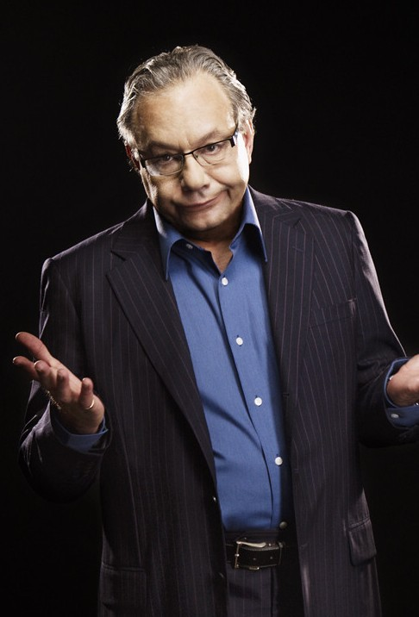
SOME ENCOURAGEMENT BEFORE WE GET ROLLING
Most of you aren’t funny, and that’s okay. Neither was I!
I used to “try too hard” and be too needy. All through my childhood I blurted out stupid things trying to be funny. I was the WORST OFFENDER at being “lame”!
But YES, being funny is a learned skill.
The more you practice, the quicker your wit. But you’ll see some results sooner than later.
Let your guard down and be reassured I’m not going to ask anything superhuman of you. If I can do this, you can do this.
You don’t have to be a comedian, I promise…although by the end of this it’s likely you’ll be on your way to FEELING like one, anyway.

Slide 5
WHAT TO EXPECT FROM THIS MASTERCLASS
Some men have undeniable advantages that are like SUPERPOWERS with women, like playing guitar/piano or having an accent. But this one is special because not only can you authentically acquire it (unlike the accent), it’s also completely portable (unlike a piano).
I’m not only going to reveal HOW to make women laugh, I’m going to show you WHY. This empowers you with the advantage of knowledge to be funny on purpose…with predictably positive results.
I’m NOT going to turn you into a standup comedian, and for good reason. Have you ever noticed that many famous ones aren’t attractive to women anyway?
Stand by for perhaps unexpected ways to genuinely be funny and make women laugh that you probably haven’t ever considered before.
So will this Masterclass be a comedic riot? Sometimes…but we also have to keep it relatively serious at times to maintain objectivity and give you actionable steps.
Ultimately, this will be both funny AND informative, like going to a magic show where the magician shows you how all the tricks are done.
Yes…you will be better at making women laugh IMMEDIATELY, and even more so with a bit of practice in the coming days and weeks.

Slide 6
GELOTOLOGY: WHY PEOPLE LAUGH
This is like learning how a clutch works before attempting to learn how to drive a manual transmission.
As posted in the Scientific American:
“Researchers do not fully understand which aspects of a joke or situation make it seem funny.”
“Various theories have posited that people find amusement in the misfortunes of others, in expressions of otherwise forbidden emotions, in juxtaposition of incompatible concepts and in realizing that certain expectations have been violated.” (aka Incongruity Theory)
“One scheme weaves several hypotheses together: it holds that humor results when a person simultaneously recognizes both that a norm has been breached and that the breach is benign.” This includes laughing at the benign misfortune of others. (aka Superiority Theory)
“Laughter in response to relief…when a disaster has been averted.” (aka Relief Theory)
“Laughter may have evolved as a way to enhance connectedness in societies.” (aka Community Theory?)
https://www.scientificamerican.com/article/whats-so-funny-the-science-of-why-we-laugh/

Slide 7
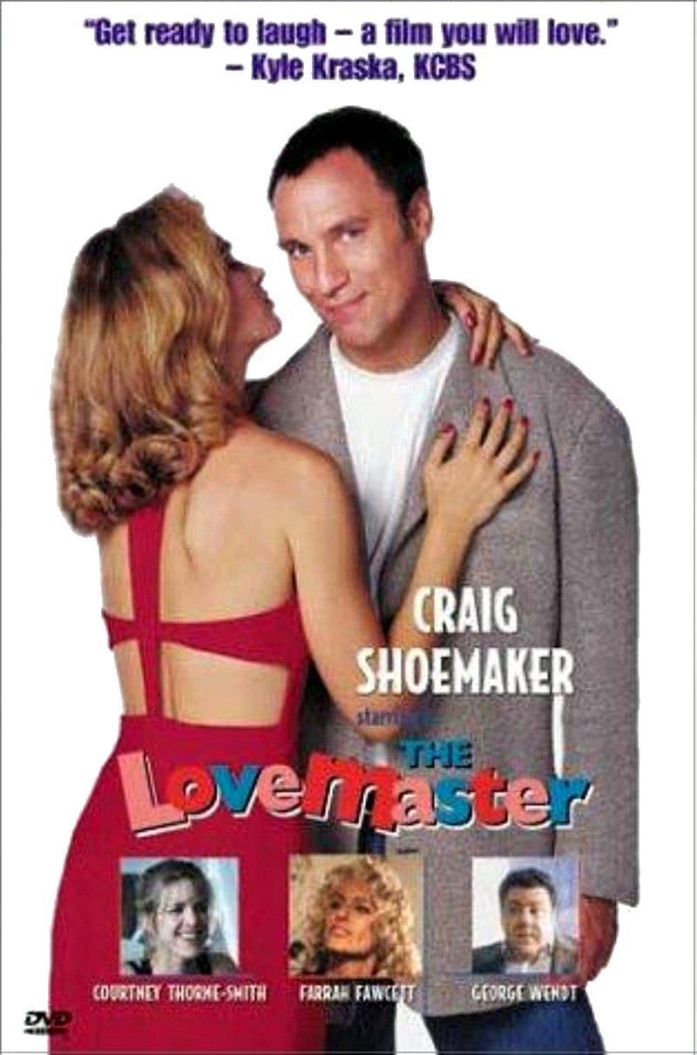
MORE REASONS WHY PEOPLE LAUGH
Women in particular laugh when they're having FUN. It’s likely nobody at “ladies’ night out is a stand-up comedienne.
Women are hard-wired to WANT to have fun. Therefore they WANT to laugh. This is why pickup lines are rooted in humor. Making her laugh is a "hook“, and a great first impression (with some caveats, of course…don’t be like Craig Shoemaker!)
https://www.youtube.com/watch?v=ieIisdMdIOg
Laughter can have an unhealthy DARK side. Consider how people laugh at a bullied kid, or revel in evildoing. It’s like a perversion of the laughter reflex to laugh at that which is NOT benign. Isn’t that fascinating?
https://www.scientificamerican.com/article/the-science-of-laughter-and-why-it-also-has-a-dark-side1/

Slide 8

BASELINE MINDSET OF PEOPLE WHO ARE GOOD AT MAKING OTHERS LAUGH
(For All The Right Reasons, Of Course.)
They don’t take themselves seriously, therefore can see the world less seriously
Not easily offended, but easy-going
Relaxed vs. uptight
Confidence vs. self-consciousness/insecurity
Curious…always exploring the world and asking questions
Generous rather than self-absorbed
Sober self-judgment rather than arrogance
Anger and bitterness is a buzzkill (Lewis Black’s entire gig is ironic)
Note that the guy who is the OPPOSITE of these things is ALWAYS the butt of jokes in comedy movies. (William Atherton, Jason Alexander, James Spader). It’s like “negative comedy” on the part of these actors, right?
You have complete control over ALL of this.

Slide 9

MOST PEOPLE THINK THEY HAVE A SENSE OF HUMOR, BUT DON’T.
This is related to over-analysis rooted in insecurity, or sometimes just jaded, mean-spirited bitterness.

Slide 10
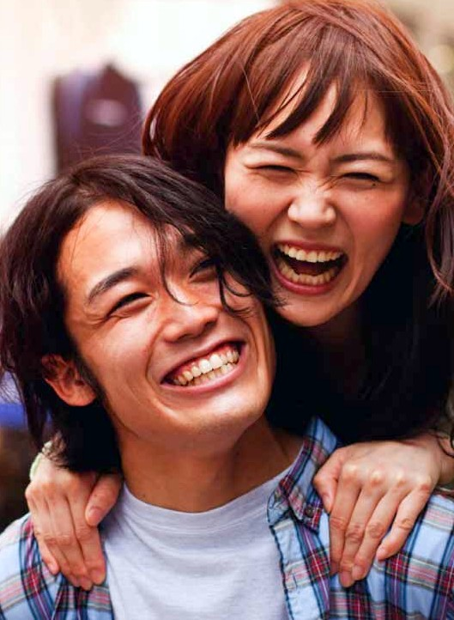
THE ALCHEMY OF MAKING WOMEN LAUGH
"If you can make a woman laugh, you can make her do anything.” – Marilyn Monroe
So, in case you’ve not deduced this already, let’s relieve the pressure FIRST, right here, right now:
YOU DO NOT HAVE TO BE A COMEDIAN TO MAKE WOMEN LAUGH.
If she’s having fun, she laughs.

Slide 11
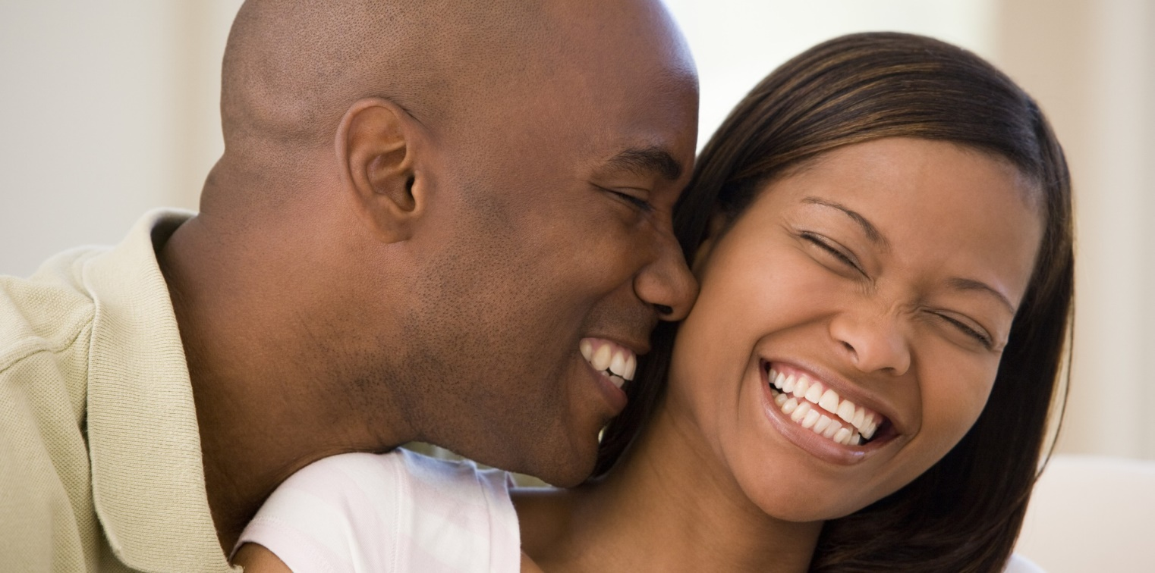
BUT YES…MASTERING THE ART OF HUMOR IS 100% WORTH THE EFFORT
It Takes You To A Level Of Super-heroics With Women

Slide 12
WHAT BEING FUNNY SAYS ABOUT YOU
Humor in men indicates intelligence, creativity, “strong genes” and a fundamental understanding of the feminine desire for play.
Therefore, men who make women laugh are seen as potentially better at providing, protecting and leading.
That ignites femininity and the primal sexual level…and yes, makes women horny.
Herein lies the magic of David DeAngelo’s legendary take on being “cocky/funny”.
It does, however, have to be the RIGHT kind of funny. (More on that coming up…)
https://psychcentral.com/lib/how-and-why-humor-differs-between-the-sexes#1
…and again here:
https://journals.sagepub.com/doi/full/10.1177/147470491501300110

Slide 13
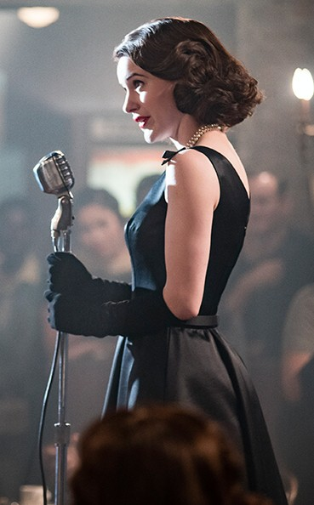
SO THEN, IS COMEDY MASCULINE?
A FASCINATING FINDING: Men do not require funny women. Do women need to make us laugh?
Studies show there’s a clear difference between men's definition of "sense of humor" vs. women's. (“she laughs at my jokes” vs. “he makes me laugh”)
There’s even evidence, albeit more anecdotal than what’s demonstrated by scientific studies, that comedic mastery is actually MASCULINE, therefore a hindrance to women attracting men. (!)
When comedienne Susan Prekel, who’s plenty attractive, takes to the stage and spots an attractive man in the audience, her heart sinks. “By the end of my gig he’s going to find me repulsive.” She reports she has only been asked out once after a gig, but the male comics are often magnets for women.
The dynamic described in the previous point is a major theme in the TV show The Marvelous Mrs. Maisel. (SPOILER ALERT: Only Lenny Bruce can handle her!)
Think about it, you LOVE women who lighten you up with fun and play…but not because they told jokes. The latter is YOUR job, in order to turn HER on.
There’s actually widespread opinion (John Morreall, Mahadev Apte, et al) that the origin of human humor is tied to relief after passing of danger as well as community bonding. BOTH of these factors are integrally tied to being a provider and fomenting safety and security.
https://journals.sagepub.com/doi/full/10.1177/147470491501300110
https://science.howstuffworks.com/life/inside-the-mind/emotions/laughter.htm
https://www.scientificamerican.com/article/the-humor-gap-2012-10-23/

Slide 14
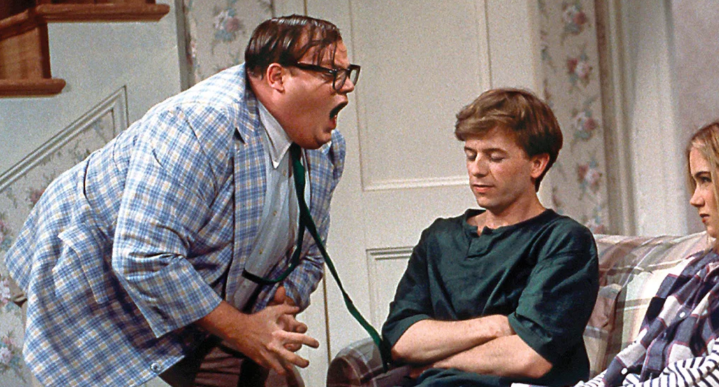
ANOTHER POWERFUL WAY WOMEN’S
“FUNNY BONES” ARE WIRED DIFFERENTLY
A Stanford University study explains why men tend to think silly, visual humor is funny and women often do not (e.g. Three Stooges, Monty Python, Chris Farley, Peter Sellers, Dumb And Dumber)
My son and I were practically hyperventilating watching Pink Panther movies and Holy Grail, but eventually both my wife and daughter walked away and did something else.
Also in this study, men tend to expect and anticipate humor, whereas women tend to be caught off guard and tickled by punchlines.
  This plays into suddenly dropping something clearly humorous working GREAT with women, while dry, somewhat esoteric humor often goes over women’s heads!
  It also explains why dry wit in online profiles is often taken seriously by women (e.g. “Oh, can I have your cat?”)
https://news.stanford.edu/.../novem.../med-humor-110905.html

Slide 15
SO WHAT KIND OF HUMOR WORKS BEST TO ATTRACT WOMEN?
Chris Farley was amazing to us, but not sexy to women. Neither is Kramer or Jason Alexander.
IRONIC HUMOR RULES Aka, “the theater of the unexpected”.
  This sends ALL the right messages, and is therefore THE area to focus on the most if you want to be funny in a sexually attractive way.
  Look to twist everything in any way possible. (e.g. rooting for injuries/Emo's bicycle)
COMEDIC RECALL is also amazing and sends all the right messages. It’s often the punctuation at the end of a pro standup routine because it’s failproof. But unlike ironic humor, situations where it presents itself are fewer and farther between (e.g. Christian parking skills)
EXAGGERATION HUMOR can work…but it’s tricky.
  Simply bigger isn’t necessarily funny. (e.g. “The mist-enshrouded mountain top fortress”, not “I have ten billion examples).
  Clowns have exaggerated costumes and Chris Farley has exaggerated movements…but NEITHER is attractive.
  More in line with this concept are most funny “yo momma jokes” (e.g. an hour and a half to watch 60 minutes)
  Also the old Johnny Carson call/response format: “This neighborhood is SO swanky! How swanky is it? When the windshield on their Rolls gets cracked, they take it to Tiffany’s.” Or, “They fill their radiators with Perrier.”
  Exaggeration can refer to something too SMALL instead of something too BIG (tiny cell phone on SNL, a small whack on my wife’s behind “cures” her back pain)
REMEMBER ALWAYS: It’s the masculine traits demonstrated by humor that make women horny, not simply humor for humor’s sake.

Slide 16
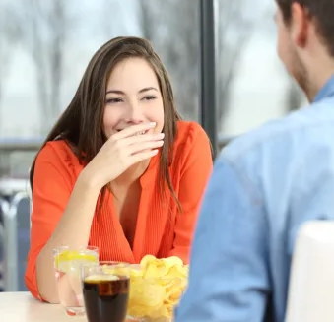
COMING FROM THE RIGHT PLACE WITH ALL OF THIS
You have to back up the right kind of comedy with the other “big four” traits that women find attractive.
The difference between being a “dancing monkey” vs. attractive is ALSO the difference between the needy comedian and the one who gives.
Can you compel yourself to GIVE that woman the gift of lightening up, just like you would any other…without agenda? What a pattern interrupt that would be!
It’s that difference between “getting” women vs. “attracting” them, isn’t it?

Slide 17
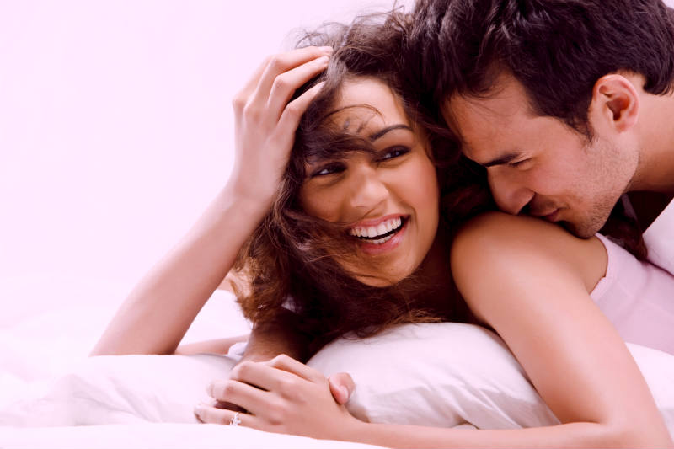
NEXT, WE’LL KICK IT UP A NOTCH WITH HUMOR THAT TAKES YOU FROM PLATONIC TO SEXUAL…

Slide 18
…BUT IT’S TIME FOR OUR FIRST CONTEST…
…Think you can drop your comedy knowledge on us?
First to respond correctly gets a FREE copy of Invincible

Slide 19
Name TWO comedians who have famously portrayed Inspector Clouseau in the Pink Panther movies

Slide 20
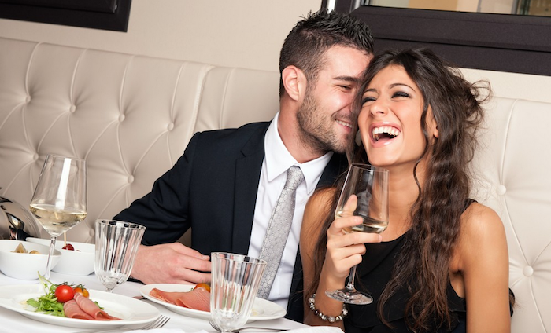
CHECK IN: ARE WE HAVING FUN YET?

Slide 21
NEXT LEVEL: HUMOR THAT TAKES YOU FROM PLATONIC TO SEXUAL
Teasing and banter as “benign wrongdoing”: This was brought up in the study I talked about earlier, but the phrase is attributed to behavioral scientist Peter McGraw of U. of Col. Boulder (ep. 238)
Benign wrongdoing makes her laugh, but is all the more magic and leads to great flirting because naughtiness is next to horniness.
Funny flirtation should start with the innocuous to get her laughing, then DIAL IT UP with naughtiness or sexual innuendo/references. If she keeps laughing, it’s ON:
  “You’d like that, wouldn’t you?”
  “That’s what SHE said!”
  “That’s bad…I bet you’re TROUBLE!”
  When she excuses herself to the bathroom: “I don’t know if I trust what you’re going to do behind closed doors!”
  Importantly, a LOT of men put the cart before the horse here.
Related to this are “whispered secrets” between only you and one other woman
Truth or dare games are invariably naughty, and can be spontaneous during flirtatious conversation.
Any whimsical fantasies AT ALL will make her laugh.

Slide 22

WHAT TO DO WHEN YOUR HUMOR IS CLEARLY WORKING
Bring the house down, then take her home with you.
First, stay patient. If and when she’s laughing in a fun way, keep doing what you’re doing for a bit.
Listen to what she says, and watch what she does.
  This is where she starts complimenting you--often with wonderment--or tells you how she’s feeling toward you.
  Watch for open, flirtatious, or even sexual body language.
  If you think you hear a sexual hint, you’re probably right.
This is when you can announce your interest and intentions with near immunity.
  Trust she is feeling all the right emotions
  Get acquainted with the “Punctuation Effect”, and use it.
  Tone down to semi-serious, but not dead-serious. Make sure you’re both still in the “glow” of the humor.
  If you haven’t asked her out yet, say, “I like you. We should go out on [specific day].”
  If already out on a date, say, “You know what?...I think you’re incredibly sexy.”
    Then WAIT for her to respond.
    A positive answer means you should suggest leaving for a place that’s more comfortable.
    If you’re already in an appropriate place for it, it’s time to kiss her.
Don’t worry if this doesn’t flow predictably, as long as the pattern is there. The mood may go back and forth a bit.
EXAMPLE: https://www.youtube.com/watch?v=QYTPpPfhmj0

Slide 23
I’D BE REMISS IF WE DIDN’T TALK ABOUT TICKLING
The science behind why we laugh when tickled is both weird and nebulous: https://www.bbc.com/future/article/20140131-why-do-we-laugh-when-tickled
But then again, it’s still laughing after all…and women are usually ticklish.
It’s true you can’t go around violating women’s space with tickles.
Turn consensual physical contact early on into tickling…e.g. “massaging your date”. It’s guaranteed to get frisky from there.
WHAT ABOUT DURING SEX? Porn will never teach you this, but laughing during sex makes for BETTER SEX. Joke, be naughty and yes…tickle her in bed.

Slide 24
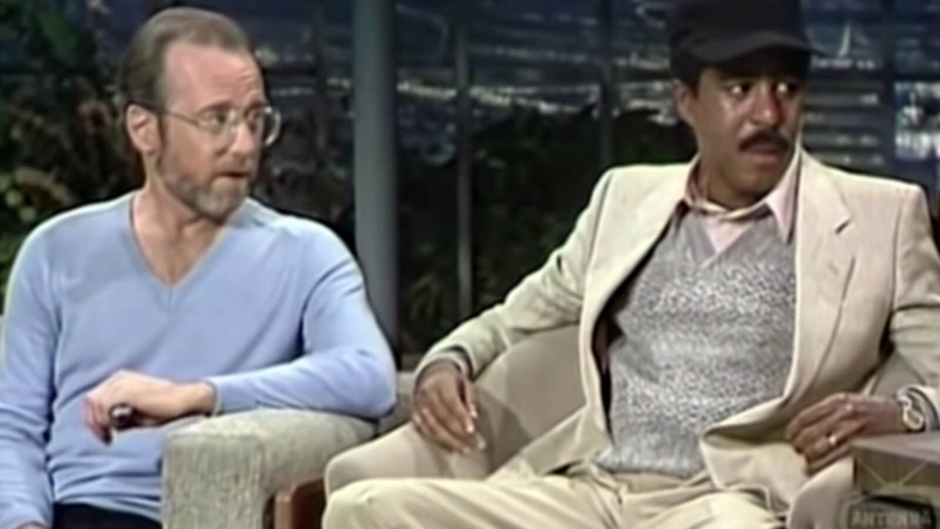
WAYS TO MASTER HUMOR WITHOUT ACTUALLY TELLING JOKES
Remember always: FUN is FUNNY, especially to women.
You do NOT have to become a comedian (even though I’m going to make you feel like one anyway…more on that later) But for now, the pressure’s still off.
This is why I harp on “warm levity” so much.
Simply remember the light-hearted tone rather than being bitter. If you can rise above a prevailing social tone of bitterness, anger or some other negative emotion with levity, you just might cause people to laugh…in “comic relief”. (Remember the reasons why people laugh?)
CAVEAT: “cranky funny” is something certain people can pull off. See: George Carlin and Richard Pryor.

Slide 25

THE POWER OF IMPROV
Many cities have cheap or even FREE improv classes. Don’t be intimidated…try it!
Being funny happens naturally during the course of HUMAN ENGAGEMENT, often spontaneously and/or by accident.
Therefore, you can safely consider ANY conversation improv.
  Develop the habit of thinking in terms of "yes, and…“
  The skill is ACTIVE LISTENING, then twisting the meaning.
  This often takes a mundane conversation and turns it into comedy and laughter. (e.g. Like the conversation with the guy at the supermarket: “I never seem to have leftovers.”…“That means you're a great cook.”…”That and I'm too much of a cheapskate to buy enough for everyone!” Or, “They're selling Halloween cookies on Labor Day?”…”Yeah, won't they be stale two months from now?”…”Now, THAT's scary!”)

Slide 26
MORE “STEALTH MODE” HUMOR IDEAS
Funny doesn't even have to be intentional or directed.
  Revel in the moments when you (or someone else) is funny by mistake
  Use this to your advantage if it's a tendency
Never be jealous of someone else’s jokes/humor ability. Pick up by doing improv with them with them and you’ll fit right in.
Being observant and curious is HUGE. Sometimes simply acknowledging what’s really going on—or what nobody else will talk about—causes spontaneous laughter. Too many men are “in their heads” when chatting with women.
Find an ironic manner of speaking whenever possible, even if it’s not quite a formal joke.
  Changing from the usual context is often funny. Throw out the rest of the coffee out and say “enough of this, already!” Like you’re mildly scolding a child.
  This may not be funny enough to elicit laughter, but simply making conversation fun puts you in a whole new light that’s entertaining and is credited to you as being funny.
Simply being light warms up the audience.
  When people are already laughing AT ANYTHING, they’re an easy audience for objective attempts to be funny.
  This is why headliner comedy acts have “warm up” acts.

Slide 27
HOW TO BE FUNNIER IMMEDIATELY (FOR REAL!)
Some of what follows involves actual intentional comedy (e.g. jokes), some is more about natural interaction…but all are EASY and you can start today.
It’s okay to have standard funny responses to certain things that you rehash EVERY time they come up (e.g. “He’s so fast he has 2 number ones on the front of his plate.”)
You can have “old standbys”. (e.g. “I have to return the coffee rental.” “McKay is a common surname in Australia, which means we have long history of naughty McKays who got sent to prison.”)
Know at least 5 funny jokes by heart: (e.g. the red shirt, Elmo’s bicycle, choir boy confession, polar bear cub, Catholic prostitute, television blonde).
Play up your funny quirks if they are endearing and charming (e.g. Yogi Berra, John Madden, Tony Siragusa)
You CAN apply your natural personality to this. Some people are quiet and “stoic”, some are more the “life of the party”. ULTIMATELY…it’s that genuine desire to lighten people up and have fun vs. being a people pleaser that will matter ever time, and you WILL be appreciated.
Remember, you can’t take yourself so seriously. Easily offended people suck. Take everything in stride.
Related to the point above, don’t be easily bullied. (e.g. “How did I do?” from Mad Men) BONUS: This and the point above are core secrets to overcoming shyness.
Remember the part about not being jealous of someone else’s comedic wit, but rather joining in? That’s key here.
Related to that is intentionally being a good audience. Laugh with other people, help them feel funnier. The “trait reversal” factor will rub off on you.

Slide 28
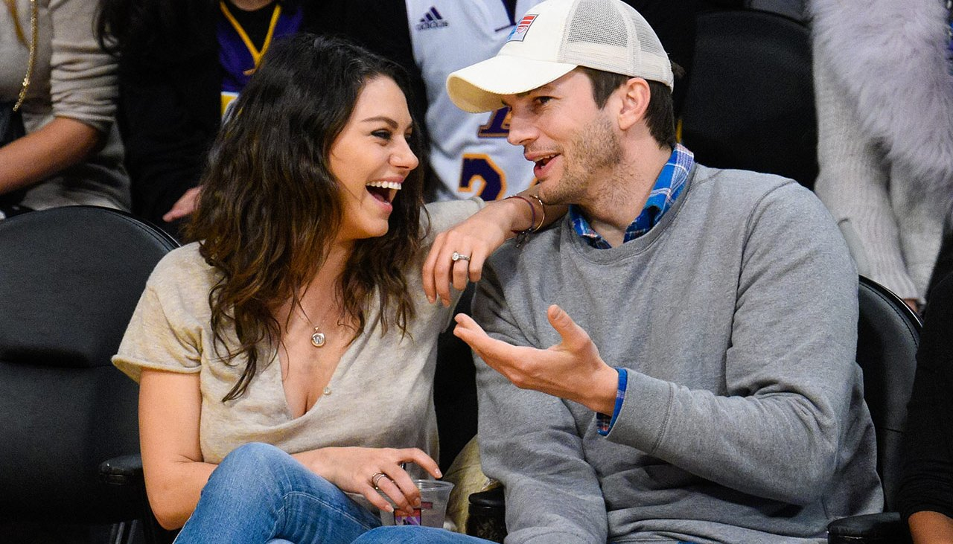
“SO HOW DO YOU PRACTICE THE MORE INTENTIONAL TYPE OF COMEDY, MILA?”
WELL, THAT’S COMING UP NEXT…

Slide 29
BUT NOW, HERE’S ANOTHER CHANCE TO WIN…HERE WE GO!
First to respond with a valid answer gets a FREE copy of Chick Whispering.

Slide 30
Who was the director of Blazing Saddles and Young Frankenstein?

Slide 31
NOW…LET’S TALK ABOUT HOW TO TUNE UP YOUR WIT AND ACHIEVE COMEDY SKILL MASTERY FAST

Slide 32
FIRST, DEVELOP FUNNY HABITS
Witty humor is like a muscle you train to be strong, then keep exercised.
It’s also a flow state you get into, not unlike speaking a foreign language or warming up for an athletic endeavor.
Be observant, and expect to find something humorous EVERYWHERE.
  Look at EVERYTHING and imagine what's funny about it.
  Concoct a funny narrative for ANYTHING and EVERYTHING (woman in curlers, man in a trenchcoat, guy driving a pickup truck full of rocking chairs)
  THE BULLDOG EXAMPLE: Every bulldog is a good boy…even if it’s a female bulldog. Man, can you imagine being a bulldog and having to have sex with other bulldogs? That’s the thing about dogs though, right? I think if I’m a bulldog I’m dating outside my race.

Slide 33
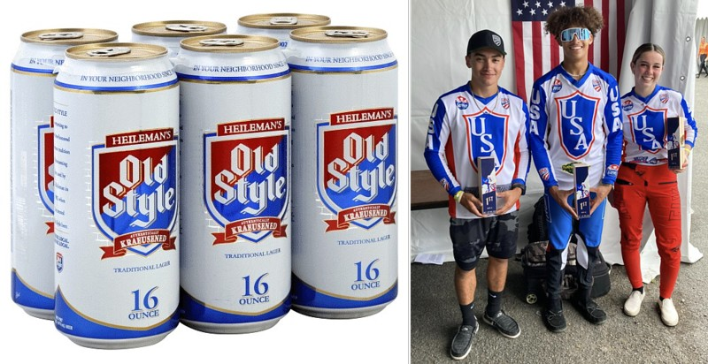
COMPARE EVERYTHING TO SOMETHING ELSE
Look for comparisons in EVERYTHING. What does this thing, person, place or situation remind you of? (e.g. Team USA looks like a six pack of Old Style)

Slide 34
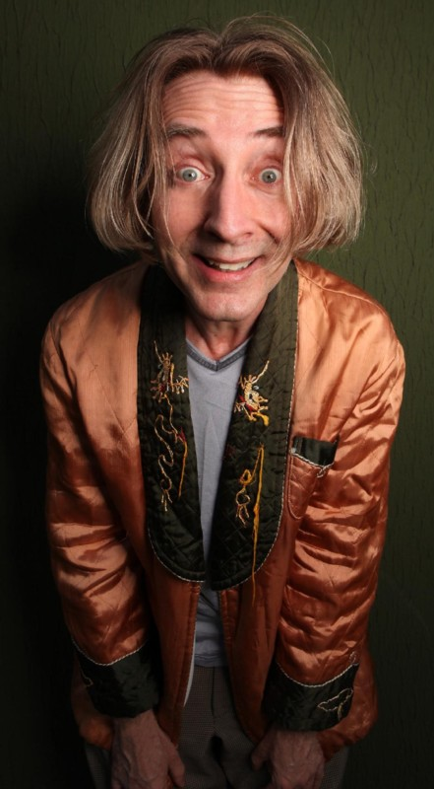
A MULTITUDE OF OBJECTIVE WAYS TO PRACTICE
First, Listen To Other Funny People And Note The Prevailing Patterns
Clean comedy rules. Dirty or profane comedy is CHEAP, and can sometimes cloud whether or not true ironic comedy is there. Either way, cleaner comedy is also PURER comedy (kind of like the water you drink?) Listen to laugh USA on Sirius XM and note the patterns.
Watch dean Martin celebrity roasts
Follow funny people on Twitter. Again, look for patterns. (Emo Philips, Ron White)
Follow joke feeds on Quora: https://jokesfunnystories.quora.com/
Watch The Marvelous Mrs. Maisel, Mr. Saturday Night and Punch Line.
Binge read these articles: https://www.vulture.com/2016/01/100-jokes-shaped-modern-comedy-c-v-r.html and https://bestlifeonline.com/50-amazing-jokes-from-comedy-legends/
In all of the above scenarios, play a game with yourself where you predict the punch line. Amaze yourself as you get better at it!
Note that it really is true that EVERY joke starts sounding like the SAME joke. When you identify that pattern and understand that rhythm, you’re well on your way!

Slide 35
HERE ARE SIX MORE…
Start Challenging Your Brain To Be Funny…In Private At First
Play along with Facebook meme questions for practice (e.g. Chicago is a band that if its name were literal, would be a terrible concert)
Play along with any challenge that comes up to think of something funny or clever. Exercise THAT muscle. (e.g. roller derby names)
Join Slogan Slingers: https://www.sloganslingers.com/writer-signup
Train your brain to tear EVERYTHING apart looking for irony (e.g. “put the BM in BMX” or “Teddy bears don’t need to eat because they’re already stuffed.”
  Sooner than later, it will become an unconscious competence.
  That will be the day you are one of the few truly quick-witted people you know.
  But it all starts with that INTENTIONAL brain trigger.
Just start thinking about anything and everything…then express your thought process out loud. This will give you a visceral and potentially humorous perspective on everything. (e.g. “Did you ever wonder why…?” “Who are these people?” “Emily wants to kiss me with a mouth full of food? It’s not like I’d floss her teeth with my tongue.”)
Thinking an extra chess move ahead often yields funny. (e.g. four empty dumpsters)

Slide 36
FIVE MORE? ARE YOU KIDDING ME?
Take Your Show On The Road!
Practice timing intentionally…which is basically acting skill. Even do so when nobody is around. WATCH the masters.
Note the “Punctuation Effect”: laughter typically happens during pauses in speech, so remember to leave time for the laugh.
Even when on a quest to be objectively comedic, there still doesn’t have to be a ton of pressure. Let the game come to you.
  Leave a notebook on the nightstand like Mitch Hedberg and write down anything funny. If it’s still funny later, it probably really is funny.
  Another test of authenticity is if you’re laughing yourself when you think of it. Before you know it, you’ll have a “tight five”.
Much like not being intimidated by improv, don’t be afraid of open mic night, either. Unless you’re in NYC, LA or Chicago, most people typically SUCK. If you take 20% of what you discover here and use it effectively, you'll rock it.
Also when you start to get good at finding humor and your wit gets quicker, put yourself in any and all positions to be funny.
  I’m personally a BMX racing and roller derby announcer.
  Another funny guy a know always hosted the Chamber of Commerce meetings (and he was a funeral director!)
When you get good at being funny, you’ll be amazed by how even pro comics leave a lot in the table.

Slide 37
THE COMEDIC POWER OF WORDS THEMSELVES
This phenomenon is both interesting AND powerful, and is therefore not to be overlooked.
… Certain words are funnier than others, and there is actual science behind it: https://www.cbc.ca/radio/that-sounds-funny-the-science-behind-why-certain-words-make-us-laugh-1.4925920
  It has to do with the mental image generated AND the actual letters in the word. Lots of “k” and “oo” sounds.
  Pickles are funnier than olives, and boobies are funnier than breasts.
  Remember Johnny Carson’s “swanky” neighborhood? Yes…”swanky” is funnier than “rich”!
I’ve also noticed certain rarely-used vocab words are funnier. (e.g. awry, belligerent, decadent, preposterous…your examples?) The irony is often found in using big, smart words to describe something inherently silly or dumb. This is therefore dead simple when you get the hang of it.
Again…putting this in action sends all the RIGHT messages.

Slide 38

TAKE ALL THE HELP YOU CAN GET
Comedians aren’t as proud a lot as you think.
Use of Props/sight gags (e.g. Zimbabwe money)
Admittedly, street magic can indeed make women laugh, and is even an open door for comedy. (e.g. The glass trick at restaurants, which you can pre-arrange) https://www.youtube.com/watch?v=AzCpcJOhQdg
Steal, steal, steal with a clean conscience…even the pros do this (e.g. “Thank you very little,” from Caddyshack.)
Yiddish is for everyone...and it's hilarious.
  The science behind why words are funnier on the previous slide is the reason why Yiddish is funnier.
  This is a big reason why Jewish comedians are funnier, too. (See how many of these words you recognize from Mel Brooks movies: meshuggeneh, verklempt, klutz, schmooze, schlep, schtupp, bupkis, tchatchke, fakakta, kerfuffle, farshlugginer, and my personal favorite fershnickert)
  While it’s arguable these words are on the silly side of humor rather than the attractive side, I’d counter they indicate creative intelligence.

Slide 39
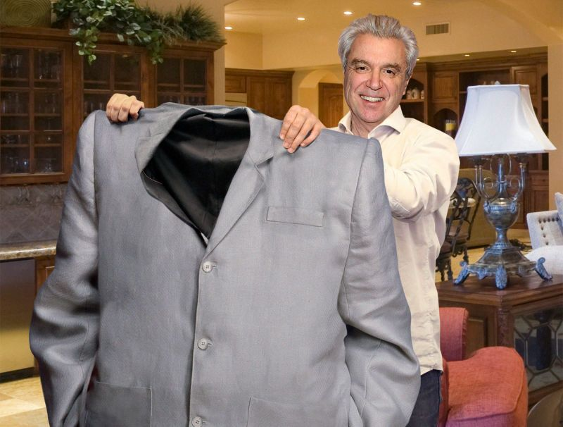
WE’RE IN THE HOME STRETCH…

Slide 40
…BUT HOLD YOUR HORSES. IT’S CONTEST TIME AGAIN
First to respond with a valid answer gets a FREE copy of Female Persuasion.

Slide 41
Name TWO comedians who starred in Caddyshack

Slide 42
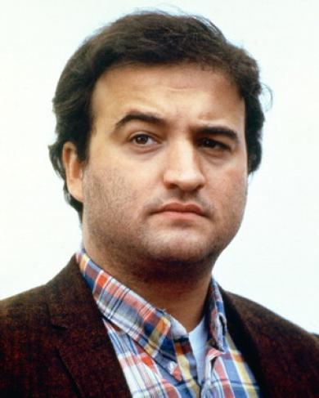
BUZZKILLS TO AVOID: WHAT’S NOT FUNNY
Thomas Veatch, humor theorist: “So what’s the point?” or “it is offensive”.
Truly vitriolic anger
  If you’re legitimately pissed off, people aren’t going to be laughing. After all, you’re not.
  Not to be confused with “parody rants” (e.g. John Belushi “But nooo!”)
Genuine self-loathing (again, not the Stuart Smalley kind of parody)
Anything dark or negative that’s not ironic
Being argumentative or opinionated, especially unprovoked (this has become a major problem in society lately)
Hurting people or animals, physically or emotionally. Being offensive is overrated.
Jokes toward social groups you haven’t earned the right to offend
Droning on about factoids and details
Extreme shyness / insecurity
Lack of clarity / being esoteric
https://www.tomveatch.com/else/humor/paper/

Slide 43
SARCASM SECRETS sarcasm [ sahr-kaz-uhm ] noun: 1) harsh, cutting, or bitter derision, often using irony to point out the deficiencies or failings of someone or something: “He resorts to sarcasm when he senses he’s losing an argument.”
2) A sharply ironical taunt; sneering or cutting remark:
This is very tricky territory. Travel with care.
The ironic form of sarcasm is the only kind to use…if you can.
  This is a staple of “cocky/funny” humor
  It’s a great way to challenge women and show leadership…but ONLY if genuinely playful and innocuous (e.g. “Sure…you expect me to believe that?” or “Oh, thanks. It’s like I’ve been looking for someone to teach me to drive from the passenger seat for several years now.” or the birthday compliment)
  Can be used to implicate “benign wrongdoing”. (e.g. “Oh, NOW you’ve done it.” or “Great…now the entire neighborhood is going to expect favors from me.”)
Ironic humor is not synonymous with sarcastic humor. Sarcasm is only a subset.
Always avoid biting, bitter, dark and/or accusatory sarcasm (e.g. “Oh that’s rich, coming from someone who failed sixth grade” or “Good grief…keep talking and I’m going to kill myself, after I kill YOU first.”)
  Women generally don’t get it, nor do they play it.
  If you meet the relatively rare woman who enjoys this, it’s still recommended to avoid it.

Slide 44
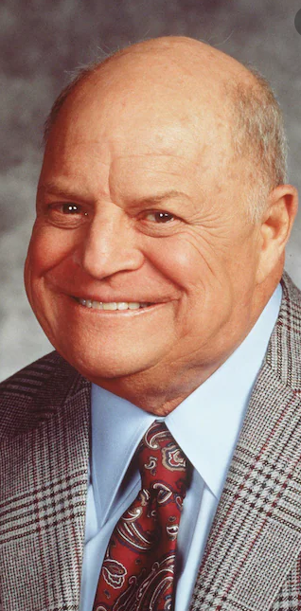
COMMON MISTAKES THAT DERAIL US IN THE QUEST TO BE HILARIOUS
Effective comedy is never about your own validation. Needy comedy makes people withhold laughter.
Comedy can’t feel like work, let alone a social ploy devoid of care. (e.g. Billy Crystal’s Mr. Saturday Night)
If you're “Farley funny” by mistake, how can you recover it as intelligent humor? If you’re naturally that way, adapt by overriding it with more attractive types of humor. (e.g. Gabriel Iglesias, Jonathan Winters)
Like with sarcasm, be careful with comedic insults.
  Don Rickles was a legend. You’re not him.
  The art of participatory insults (where you insult yourself as well). (e.g. Team Great Wall Of China…if I tried that….”)
  Never drop hurtful insults trying to be funny. They have to come from a place of love.
  Focus on light, silly factors; avoiding anything the person you’re joking about is likely self-conscious about and/or can’t control.
  If you aren’t good at social awareness and/or “reading the room”, then avoid this genre entirely. You won’t be worse off for it.
  “Negging” wasn’t ever meant to be funny.
  Note how biting sarcasm goes “hand in glove”.

Slide 45
THE ULTIMATE COMEDIC CRIME: HOW TO AVOID BEING LAME
What Are The Ways People Sabotage Their Own Attempts To Be Funny?
Trying too hard instead of patiently letting the game come to them
  Blurting out attempts at humor when it’s not your turn
  Insisting on trying to be funny when at best there’s been no “warm up”, or at worst it’s flat-out inappropriate
  If you have to work too hard to cobble a joke together from the given circumstances, let it go for now.
Too mean/insulting/creepy
Unclear motive (“Did you really MEAN that?”) LOTS of guys are oblivious to how people don't know if they're joking or not.
Too esoteric (you have to think about it too much and/or the references aren't exactly common knowledge, like Lucent engineer humor)
Too much of a hit on your own intelligence (e.g. seeing the emblem on an Audi, “What is that, an Olympic-mobile?”)
  It's that you're trying to look quick and smart, but end up a Dunning-Kruger mascot.
  Note the difference there between that and strategic self-deprecation.
Too needy (i.e. “Look at me!")
  Stealing the spotlight indicates you need people to approve of you.
  On the other hand, if you naturally enjoy lightening others up, it’s magic.
When there’s simply nothing funny there (Hint: Are YOU laughing?)

Slide 46
WHAT TO DO IF YOU FAIL IN THE MOMENT
Don’t panic! Realize either you’re contending with a humorless “tough audience”, or (more likely) you probably deserved it. What a great opportunity to take yourself less seriously, right?
If a joke falls flat but shouldn’t have…
  It’s standard procedure to follow-up with standard “punctuation” phrases.
  “See what I did there?” helps if it’s just a bit too over someone’s head at first and they need help. This happens OFTEN when joking with women.
  “I don’t care who you are, that’s funny, right there.” This old Larry The Cable Guy standby is golden if your humor needs about a 10% boost to really get people laughing.
  If done right, this “recovery process” makes women laugh even more than the original joke could have or should have. It’s like a 2-for-1.
If a joke straight-up fails…
  Be self-deprecating in a fun sense, rather than panicking or brooding.
  Try foolproof lines like, “2, 3, 4”, “Okay then…anyway”, or “That one was hilarious on paper, I promise”. Also, “What? And I stayed up all night writing that one.”
The more you have to explain, the less funny it gets. Just let it go. You’ll get another chance at redemption (which when happens, is an OUTSTANDING opportunity to apply comedic recall…ergo, another 2-for-1 opportunity.)
Don’t let it ruin your comedic confidence. Even professional comedians bomb! (“Dying is easy…comedy is hard!” – Edmund Gwenn)

Slide 47
IS IT REALLY FUNNY?
Humor is a variable. Here are practical ways to “read the room”.
Moms and kids love dad jokes, but be careful with a groan being as good as a laugh.
Puns are controversial. Proceed with caution. I personally drop them sparingly, usually as the aforementioned "dad jokes“.
What if she’s an attention whore? Is this such a bad thing? Why not give her attention that isn’t “supplicative”, but rather makes her laugh in all the right ways? Wouldn’t everyone be happy in that context?
It’s generally best to wait for a social green light that off-color jokes are okay. My BMX track is on the grounds of a Baptist church, which keeps me in check. I actually said “ass” once and apologized profusely. (“I’m not a very good Baptist, am I?”)
Not all jokes that poke fun of an entire social group are created the same. Blonde jokes and lawyer jokes are offensive to fewer people than racist jokes. Whatever happened to Pollock jokes?
Even self-deprecation is tricky.
  Never make yourself the butt of jokes if you’re not in a social power position.
  But if you are potentially intimidating or overwhelming to others, etc. that’s when to mix some in.
Contrary to what you’ve heard, it’s sometimes okay to laugh at your own jokes.
  Laughter is contagious, and you sense these folks need and—importantly—WANT to “lighten up” (within reason)
  If you sense your “audience” is shy, a bit fearful and/or socially awkward, participating with their tentative laughter at your humor helps put them at ease. We know THIS is an attraction factor with women.
  It’s almost always okay to laugh at your own jokes when your humor is based on an observation. That’s a case of inviting others into your fun, hilarious realty. It only makes sense to laugh together.
  The biggest mistake is to laugh at your own jokes purely to foment approval.

Slide 48
BEING FUNNY ON PAPER
Humor “out loud” can also be another key variable compared to the written word. (e.g. The interrupting cow vs. How do you tell the difference between a chemist and a plumber? Ask them to pronounce “unionized”.)
At first glance, being funny on paper is easier because you have more time to think about it.
BUT…it’s also harder because you don’t have timing or non-verbal inflection on your side.
It’s even more of a moral imperative to make humorous intent absolutely clear when it’s written. Women often don’t get it otherwise. (Remember how women process humor vs. men.)
Don’t count on emojis to bring clarity. Laughing/crying emojis are often used derisively.
Use of ironic sarcasm can play out very differently in print vs. when spoken. (e.g. “That’s just peachy.” or even “Great. That’s what I needed right now.”)
Generally speaking, the general guidelines of humor—especially attractive humor—mostly all apply.

Slide 49
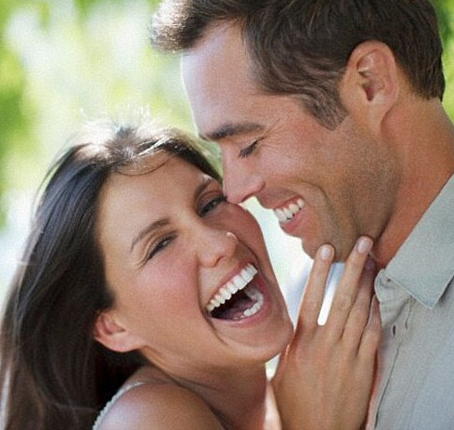
SET THESE “MENTAL TRIGGERS” TO GREENLIGHT BRINGING THE HUMOR
Bring levity to minor stressful situations and be a HERO. It’s a great example of keeping your head when all about you are losing theirs, and therefore VERY masculine.
“Reading the room” in particular if women are in distress and/or upset.
  First care and listen.
  The opportunity to “lighten her up” will eventually come.
  See also: When is it okay to laugh at funerals?
Joking when something bad happens to you is the stuff of legend. (e.g. “Lakanooki”, “I hope you all are Republicans”)

Slide 50
THE ULTIMATE CHALLENGE: CHICKS WHO ARE QUICK ON THEIR FEET
First and foremost, they’re extremely rare (and usually redheads or Latinas…ha!)
“Quick on one’s feet” isn’t synonymous with “funny”.
  She’s more likely to be a whip-smart heckler than a stand-up comedienne.
  Remember that women who tell jokes aren’t attractive to men, so she likely knows better.
You’re probably the only one viewing interactions together as competition
  She doesn’t want or need to beat you at anything
  “Going toe-to-toe with her” is nice, but not necessary
  Simply saying, “good one” is likely enough
Are you really attracted, or simply feeling insecure…as if you need to acquit yourself? (HINT: “Putting her in her place” is not going to come off as attractive to her.)
Such women have a HARD time dating
  The vast majority of men are intimidated for the above reasons…and that turns her off. She often won’t understand why, after all “she’s just a girl” (their words, not mine!)
  They usually can’t find men who can “handle them” (read: “connect with them”)
  …And those who can usually aren’t willing to.
Banter with them FTW. Don’t overcomplicate this—it’s only “back and forth”, not a “yo mama” joke contest. Every secret to attractive humor wins most good women over, including these women.
She’s only worth the effort if she’s a good-natured sweetheart, not mean-spirited. The “big four” and being “connectable” still apply.
Confidence vs. “trying too hard” for the win here…more than ever

Slide 51
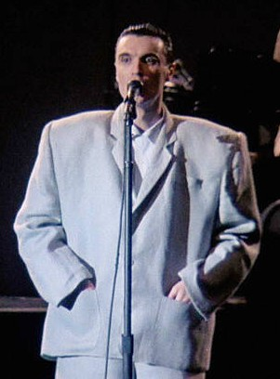
NO MATTER WHAT, SOMETIMES IT STILL GETS COMPLICATED
Only David Byrne could pull of the “big suit”, right? That’s an inherent social boost, especially if you already have some social proof.
The “big suit” wasn’t sexually attractive, but the attitude behind it was. He was poking fun at “established” principle and owning it. (i.e. his acting coach’s advice that everything on stage has to be “bigger”)
The “screw you” angle is the ultimate ironic twist, as if the joke is really on the audience itself. That can be sexy.
It was a solid take on comedic self-deprecation, which make his audience adore him more. (i.e. “This made my head look smaller.”)
Nevertheless, was this really attractive comedy, or not?

Slide 52
FOR MORE
Visit https://www.scotmckay.net
FREE download of Deserve What You Want
FREE episodes of The Mountain Top Podcast
Talk to me FREE for 25-minutes
Masterclass season tickets

Slide 53
©2022 X & Y Communications. All rights reserved worldwide. Copy and/or distribution is strictly prohibited without express written permission from the publisher.
THANK YOU

Slide 54
QUESTIONS AND ANSWERS

