Slide 1

FOR MATURE AUDIENCES ONLY
Host: Scot McKay

Slide 2
PLAN OF ACTION
There are plenty of practical steps, and we’ll hit the ground running very shortly.
Most of what I’m about to present is BRAND NEW. Any info I bring up from previous programs will be elaborated upon.
There will be contest questions asked a few times during masterclass, w/ prizes to the first correct responder.
Time is reserved at the end for all of your Q&A, although you can submit questions during the class.
Yes, this is being recorded. You will have full access to the video and the slides in a dedicated portal.

Slide 3
GROUND RULES
Come with an open mind and a positive attitude.
Although this slide deck will be made available to you, take notes as you see fit.
Turn off any and all distractions.
Please do not unmute yourself unless it’s your turn to speak.
Abusive, disruptive behavior will not be tolerated. We will practice mutual respect.

Slide 4
MINDSET TIPS AS WE GET STARTED
Certain topics may or may not apply to you. Please don’t tune out.
A 40-year-old guy may relate to something a 70-year-old won’t, or vice versa.
I’ve done my level best to focus on what will be relevant to a larger cross section of men.
Bear in mind that what’s not relevant now may very well be relevant someday, and you’ll have that 20/20 foresight.
YES…there is a special bonus in the Download Area for men of retirement age

Slide 5
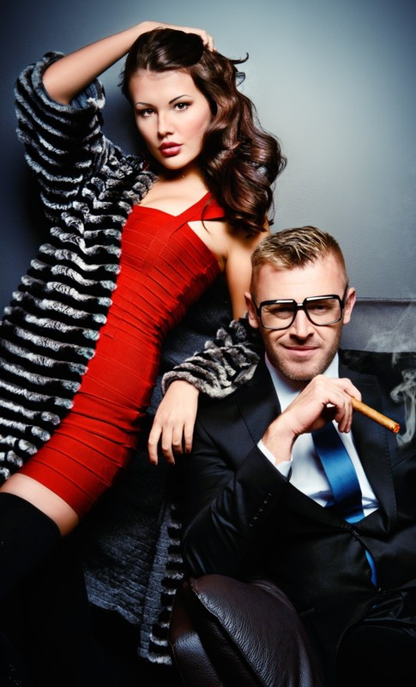
ABOUT YOUR AGE
There are a LOT of you guys out there in the X&Y Communications audience…35-89 in age
Turning 21 is NOT the only rite of passage. Most men change at 30, and I’d argue around 45 as well.
Stereotypes don’t necessarily apply (even though every stock photo shows a couple drinking wine at a nice restaurant)
IMPORTANT: No matter how old you are, you are NOT washed up. (I felt that way at 34!)

Slide 6
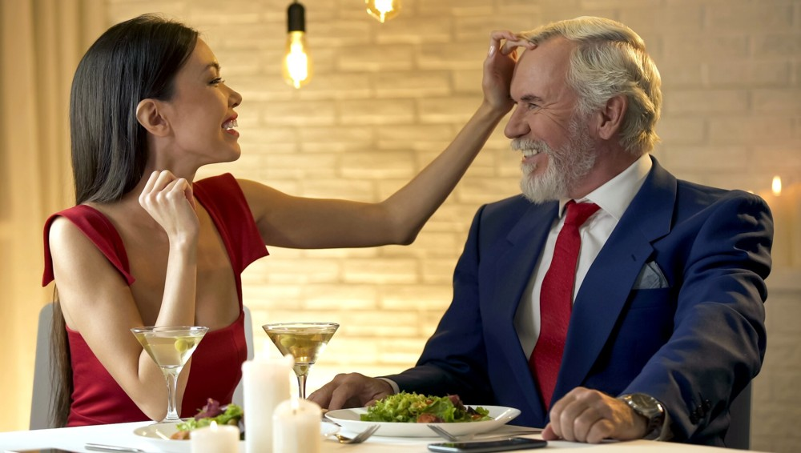
COMMON MISCONCEPTIONS
Sex doesn’t matter after a certain age (i.e. “kissin’ don’t last, cookin’ do.”)
You have to leave the country to find a woman who wants you (please avoid Ukraine right now)
You can talk a young woman out of wanting kids
No money, no honey
Contrary to every stock photo in this deck, you can still do active dates…not just dinner.
It’s (still) about looks, yet never has it been LESS about looks.

Slide 7

WHAT’S THE SAME FOR MATURE MEN
Sex happens
Women NEVER stop being fun and playful
The masculine/feminine dance in general is timeless
Flirting and seduction remain crucial
Importance of connection
Attraction to women your own age (God’s “dirty little trick”?)
If you had mojo before, you can get it right back!

Slide 8
WHAT’S DIFFERENT FOR MATURE MEN
Women and the masculine/feminine dance DO NOT CHANGE… But dating HAS.
Your family and friends have fewer people to introduce you to.
Having been around the block, loss of idealism in exchange for realism (not to be confused with optimism)
Kids are in the picture, both young and grown up
You’re probably at a different place in your career
You may be more tied to your locale. (This is a consideration before getting roped into a long-distance relationship.)
The cultural elements you surround yourself with are likely different…yet you remain rooted in your past relative to your core interests
Legacy-related issues
Possibly health and stamina

Slide 9
PITFALLS TO BEING A MATURE MAN
A Reckoning Is Upon Us: More and more older women these days want YOUNGER men. They cite older guys being sick, cranky, sloppy, lazy and drunk.
Indeed, a lot of us become LESS FUN when we get older. We have to fix that.
Testosterone-level driven detractors
“Broken halos” when relationship idealism meets reality (we’ve been around the block)
  Nobody reaches 35 or 40 unscathed
  The divorce 50/50 factor
  Discouragement regarding faith
  Bitterness and skepticism regarding women and “true love”
  Past mistakes and consequences
“Set in your ways” mentality
  Changing this is a decision.
  This can present in subtle and even unexpected ways (“You mean not everyone does this?”)
  Being stubborn about your TYPE of woman and the expectations you set for what she’s going to be like.
  DO NOT try to replace your ex!

Slide 10
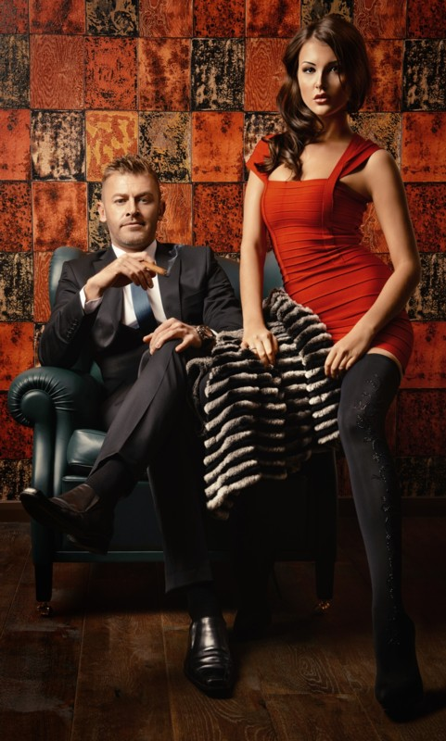
THE CASE FOR US AS MATURE MEN
Compiling wisdom…which is important not only to life success, but also to attraction because it inspires confidence and increases safety/security.
Greater life experience
Increased knowledge (e.g. “Middle-Aged Man” on SNL)
MTV generation traits versus grown-ass man traits
  Focus on what’s important in life comes with age, and that’s wildly attractive to women
  Inspiring confidence
  Calm, cool and collected
  Solid decision making
  Assertiveness, based on having seen it all
Less sexually needy and/or pushy
Many women would argue men are MORE attractive in a “distinguished’ way as they get older

Slide 11
BOTTOM LINE:
There are physical, familial, professional, cultural and legacy-related ramifications of relationships when you’re an adult.

Slide 12
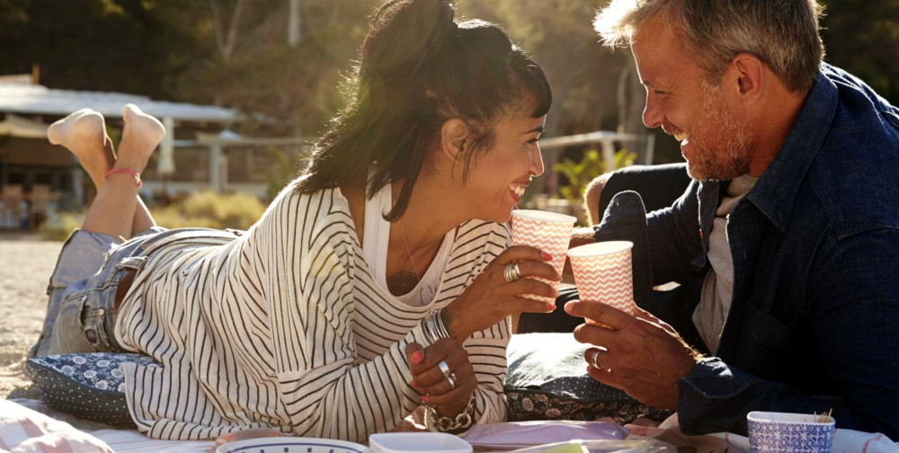
YOUR FIRST AND MOST IMPORTANT DECISION:
What do you want…and don’t want?

Slide 13
NEXT, WE’LL TALK ABOUT DATING YOUNGER WOMEN AND DATING WOMEN CLOSER TO YOUR OWN AGE…

Slide 14
BUT FIRST, IT’S CONTEST TIME
…and it’s ALL old skool pop culture tonight.
First to respond correctly gets all four of my e-books

Slide 15
What color were the “arts and entertainment” pie pieces in the original Trivial Pursuit game?

Slide 16

CHECK IN TIME: HOW ARE WE DOING?

Slide 17
YOUNGER WOMEN: WHY IT’S A REALISTIC GOAL
PLENTY OF YOUNGER WOMEN LOVE OLDER MEN
Wiser and more interesting (the Dos XX guy was in his 70s)
Better in bed (regardless of what Sarrah Rose thinks)
Generally more financially stable
Less drama
Better at “inspiring confidence”
Better at treating a lady
Mental strength trumps physical strength
“Daddy issues?” (This has to be covered)
THE ACE CARD: We are no longer in awe of or scared of women
There’s a bonus in the Download Area for you with more.

Slide 18
BUT…WE AS OLDER MEN CAN TRULY SUCK AT ATTRACTING WOMEN
This can mean attracting younger women OR women our own age. Either we’re attractive or not.
We’re still in awe of women, or scared of them
when we have “ex issues” or other “bitter baggage”
When we’re weaker or less healthy
When we’ve forgotten how to have FUN
When we’re stressed
When we’re jaded
When we’re stubbornly set in our ways
When we resist change/modernity
When we lack experience, the stigma is heightened as we get older
ALL OF THESE ARE WITHIN OUR SPHERE OF CONTROL

Slide 19
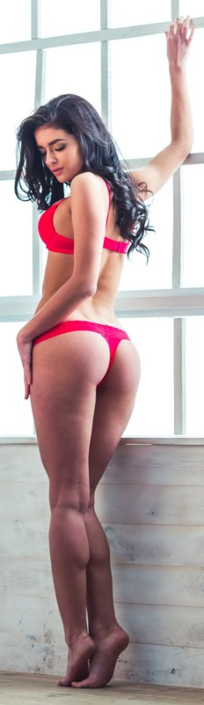
THE (PROBABLY OBVIOUS) BENEFITS OF DATING YOUNGER WOMEN
…ALONG WITH THE ASSOCIATED CHALLENGES
We know all the positives, and they’re often very real.
  They’re tight, sexy and beautiful
  They bring more vivacious energy into your life
  They’re unpredictable and exciting
  They build your social proof
  They put you in an “alpha” position with your peers
But…you have to standup to immaturity, otherwise she’ll drag you down to her level and beat you with experience.
Women, not girls rule your world. No “babysitting” in the form of playing to her younger age. Influence her to be a grown up. (Act her age, not her shoe size.)

Slide 20

POTENTIAL CONCERNS WHEN DATING YOUNGER WOMEN
They’re going to want babies, gentlemen.
  Too many men think selfishly
  Be especially mindful of women in their 30s who don’t have kids yet
  You’re NOT her guy long-term if you’re not giving her that
You MUST match her activity level, or you’ll lose her. (Jay Leno: “It’s like dating an aerobics instructor. She’ll always be better than you.”)
Her friends and her social circle in general are NOT going to be your age. Can you hack it?
Younger women are in awe of older adults, as you were when you were young, and you can’t be there for it. You can’t be in awe of her. That won’t make sense to her, which is why if you are in awe of HER, you’re immediately unattractive.
On a related note, you MUST stay out of the “Just Be Mentor Zone”. She can be impressed, but you can’t be full-on in the JBM Zone

Slide 21
A THICK SKIN IS REQUIRED
If you want to date women MUCH younger, you HAVE to have a be “rejection” proof.
  The greater the age difference, the lower the ratio of women who will be interested.
  The “Getting Beat By A Girl Factor” stings more when she’s much younger than you.
  You absolutely cannot let your ego get in the way, or you’ll stay on the sidelines every time.
Charming younger women, making them adore you and getting ego strokes is VERY different from them agreeing to be romantically involved with you.
  You may be older than the father she’d have to introduce you to.
  If she has to hide you from family/friends for social reasons, that will incite guilt and shame…which hurts
Yet, younger women may FLIRT with you and be ATTRACTED, but might not DATE you or have SEX with you. That’s NOT “rejection”. (More on this in the next slide)
Wanting to play with you but NOT marry you is NOT “rejection”.
You are NOT creepy because you are older—even if she says so. You are only creepy when you do creepy things.
Perceived “rejection” has nothing to do with you personally if it’s age-related.

Slide 22

HOW TO “READ THE ROOM”
You have to objectively identify the truly eligible younger women…proof positive.
Remember always: Flirting is a DIAL, not a SWITCH. You don’t have to go “all in” up front. You can measure her responses.
The “Half Step For Younger Women”: Lead with a comment about how younger men are immature and see if she runs with it
Tease her in an age-related way, putting yourself in the power position
Watch for HER to compliment you, express appreciation for more mature men and/or turn it sexual.
Women tend to be extremely protective sexually, so all signs you may potentially see will likely be intentional

Slide 23
THE HALF YOUR AGE + 7 RULE?
It makes sense, but the only real absolute is legality.
You must both be authentically on the same page, or else it’s all a categorically a bad idea.
Ulterior motives are NOT authentic ones
Again…can she feel comfortable introducing you to a dad who is 20 years your junior? Can you?

Slide 24

NOW IT’S TIME TO TALK ABOUT WOMEN CLOSER TO YOUR OWN AGE
HOW ARE WE DOING SO FAR?

Slide 25
THE CASE FOR DATING CLOSER TO YOUR OWN AGE
Women are looking fantastic into their more mature years nowadays rather than “losing their looks” by 28 or 30.
Clear sexual advantages (why we love MILFs and “cougars”)
The “weird” advantage of having gotten past idealism
Similar life experiences…both good AND bad (which isn’t bad)
Sharing pop-cultural history is NOT to be underestimated. My wife is a mere 5 years younger and it’s amazing what she has never heard of.
Better wisdom and better decisions (just like you)
More life skills to bring to the table (e.g. interior decorating, doing the taxes, saving money, etc.). Indeed they’ll be better at whatever they’ve been practicing over the years, albeit that may include “dark side” traits as well like manipulation, etc.
Less likely to have an entitled “sugar baby” mentality

Slide 26
THE BEST-KEPT SECRET OF ALL
35 y.o. women who LOOK 23
I personally LOVED this phenomenon. It was my secret weapon.
All the benefits of younger women, fewer of the pitfalls.
Such women will quite likely continue to age well.
They not only LOOK 23, but tend to have 23 y.o. energy in combination with 35 y.o. maturity. (i.e. they not only look 23, they SEEM 23…in the best way possible)
They’re the ones you overlook at the grocery store because you thought they were “too young”.
They’re often dateless, because only frat boys are asking them out, not grown-ass men.
Not limited by race, height or body shape…although “cuter” women tend to appear younger
Women like this are NOT a fluke. There are more than you think, especially nowadays.
Emily, my dental hygienist and at least two other women I dated seriously all fit this description.
Know the signs of an older woman who looks significantly younger.

Slide 27
“WAIT, CAN’T YOUNG WOMEN AGE WELL, TOO?”
YES, of course they can. For example, I dated a 24 y.o. who I thought looked the same age as the young looking 35 y.o. women I was dating. But 16 years later she still looks the same, which is to say fantastic. So it’s a “box of chocolates” with young women, but I will say by 35 you have a pretty good idea of how time will treat them.

Slide 28

WHAT ABOUT THE IDEA OF “SEXUAL CAPITAL RETURNS”?
The basic idea is fleeting female beauty vs. increasing male net worth
This was popular among the PUAs and nowadays among “redpilled” guys
It’s a cheap view of humanity in general. (Is this really what relationship with women is all about?)

Slide 29

HOW “GOD’S DIRTY LITTLE TRICK” ACTUALLY APPLIES TO THIS TOPIC
Women our own age tend to be attractive to us, no matter how old we get.
I personally would never have been attracted to even 25 year old when I was 18.
Sex with the lights out? Older women will be FAR more forgiving of your older physical body than you think, and some younger women may be too.

Slide 30
REAL-WORLD CHALLENGES TO DATING WOMEN YOUR OWN AGE
Let’s just call it out: baggage
  Emotional
  Objective/material
  Kids
  Crazy exes
The older we get, the more profound our responsibilities at work and at home.
Dating single moms…that will be her biggest priority, regardless of the kids’ ages.
“Set in your ways” mentality. Changing this is a decision on her part as well as yours.
WATCH OUT for pressure from career-minded women who wake up at age 36 wanting a baby
When it comes to sex, the STI and the birth control conversations are ALL IMPORTANT.
  Don’t assume anything. Don’t believe what she tells you carte blanche about tubal ligations, etc.
  Women are going through menopause later (Emily is 51 and hasn’t yet)
  Highest rate of STI in the country is The Villages, FL.
HONEST QUESTION: Will you judge her for being a divorced mom at 35? Or rather, for never having been married before?

Slide 31
OBJECTIVE DIFFERENCES BETWEEN WOMEN WHO HAVE KIDS AND THOSE WHO DON’T
SINGLE MOMS
NO CHILDREN
May have had enough
More realistic
Unfazed, pretty much unoffendable
Embrace silliness and laugh at your “dad jokes”
Take themselves less seriously
More down-to-earth
Easier to please, content
Decidedly more mature in demeanor and purpose
Likely want kids
More idealistic
Easily grossed out and offended
Roll their eyes at dorkiness
Take themselves more seriously
May focus more on frivolity/materialism
Harder to please/higher maintenance
More likely to be spoiled/bratty

Slide 32
OBJECTIVE DIFFERENCES BETWEEN WOMEN WHO HAVE BEEN MARRIED BEFORE AND WHO HAVEN’T
BEEN MARRIED BEFORE
NEVER BEEN MARRIED
More realistic
No need for a huge 2nd wedding
Understands the reality of what we as men are like
If they don’t like men, it’s more likely because of their ex specifically.
Not as concerned about what friends think and/or social appearances
Less of a rush to get married
May be jaded against re-marriage in general
More idealistic
Will want a “fairy tale” wedding
Potentially unreasonable view of what men are like
If they don’t like men, it’s because of general experience or what they’ve been taught
Cares more about what friends/family think of you
May pressure you to get married
Or…may or may not be excited about marriage

Slide 33
WHAT IF SHE HAS BEEN MARRIED MULTIPLE TIMES BEFORE?
Wait…what if YOU have?
Is she divorced, or widowed, or both?
What were the circumstances?
  Was she young and foolish…or naïve?
  Has she fallen for manipulators?
  Was she simply a victim of bad luck (e.g. swindlers, con-men)
Does she simply have a “bad picker”?...
…Or is SHE the common denominator?
Watch closely for red flags that signal patterns of relationship destruction.
Let her explain herself, and evaluate from there.

Slide 34

SO…ARE YOU READY FOR SECRETS TO STAYING SEXY AND ATTRACTIVE TO WOMEN AS A MORE MATURE MAN?
…Of course you are.

Slide 35
BUT WAIT…IT’S CONTEST TIME AGAIN
First to respond with a valid answer gets a FREE copy of all five of my Amazon bestsellers…in rare PDF format.

Slide 36
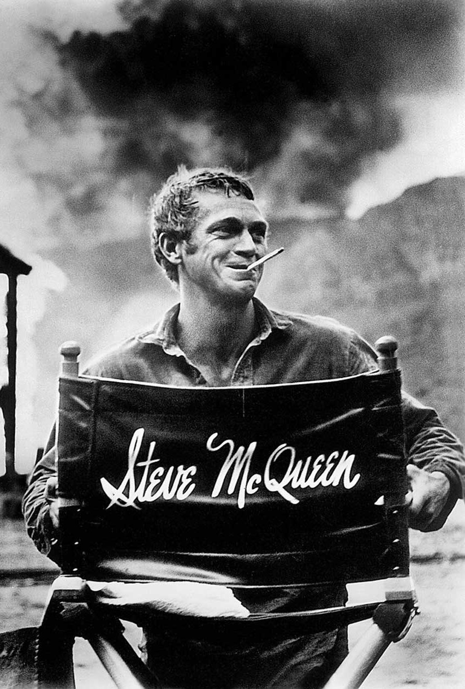
Name a movie starring Steve McQueen

Slide 37
BRIEFLY: STYLE AND APPEARANCE
This is a larger topic for a complete Masterclass of its own
Do your best with what you’ve got. This is what women REALLY find attractive.
You aren’t 20 or 30 anymore, and that’s okay
  No backwards ball caps
  Consider avoiding shorts unless absolutely necessary
  In general, don’t attempt to dress younger. That’s not why women like younger men anyway.
A key word is “composed”. Clean and neat vs. disheveled or “thrown together”.
Reflect the best aspects of your lifestyle
Pay attention to your shoes and your haircut
Being a grown-ass man does not mean you are boring
Definitely guard against surrendering to looking and acting like an old man…regardless of your age.

Slide 38
HOW TO STAY SEXY WELL INTO YOUR MATURE YEARS
A well-known study showed that men who are considered attractive by women stay so until 55 (which is how old I am!) The goal is to beat that number.
Guard looking and feeling sexy as if your life depends upon it…because it probably does.
Staying active (AT ALL)
Reasonably healthy diet
Getting a halfway decent night's sleep
Drinking a gallon of water per day
Consider QUITTING alcohol, and smoking of course.
The link between physical health and psycho-emotional health is real. You get depressed and give-in to getting old when you’re less physically healthy. It’s a dirty trick!
If you have to fight your way out of a destructive “washed up” mindset and back into one that celebrates years of life ahead, do what have to do.

Slide 39
YOUR LOOKS STILL MATTER…TO SOME DEGREE
Should you color gray hair and/or handle baldness?
  This matters WAY less to women than we’ve always thought…perhaps less now than in the past.
  DO NOT get a hairpiece. Even the world’s best ones are easy to spot.
“Dad bod” is not a deal-breaker, but being straight-up out of shape is.
Do it for YOU, not her. The women will follow.

Slide 40
WHAT IF I LOOK OLDER THAN I REALLY AM?
Watch your sleep position (seriously)
Be man enough to use moisturizer
Drink more water, and less alcohol
Get more sleep
Manage stress…recreation and staying active helps immensely, as does letting yourself laugh and have fun.
Quit smoking and abusing drugs NOW
Take supplements, especially zinc, Mg, over-50 multi, K. Read up online then consult your doctor or a nutritionist.
Ride herd on dressing and/or acting “old”, especially your haircut.
Take control of hair loss
Watch your posture. This is highly under-rated.
  Be proactive about standing straight with your shoulders and head back. No “head forward” posture.
  Stand more, sit less
  Pay attention to your position when standing still. No hands behind the back.
  Work on your core
  Rob Brinded’s “Walking Code” is HIGHLY recommended (and there’s a bonus from that program in the Download Portal for you).

Slide 41
WHAT IF I LOOK YOUNGER THAN I REALLY AM?
First, quit complaining. Nobody wants to hear it!
Your youthful appearance can be a mixed blessing, so don’t play up to it. Let it stand alone…as an appearance factor.
Dress like a grown-ass man and act your age. Resist any temptation otherwise.
Don’t hide your chronological age from women, but don’t be ashamed to admit it, either. No dishonesty allowed.
The truth is this may be the perfect storm for younger women who actually prefer older men.
If you’re ever annoyed or disrespected because of your youthful appearance, take it in stride. Then, be sure to…again…act your age.
Don’t get too cocky. You may look your age someday.

Slide 42
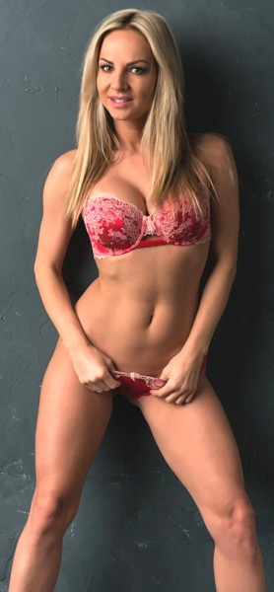
CONQUERING SEXUAL CHALLENGES
Again…this is an entire potential Masterclass unto itself
Let’s address sexpectations first. Should you really be able to perform like you did in your twenties? Would that even be a good thing?
Again…dietary factors and hydration matter
Zinc is an amazing supplement
If you have erectile and/or PE problems, research all resources before jumping to conclusions
Recreational Viagra or Cialis?
Always go on dates well-prepared with high sexual energy. Avoid masturbation beforehand.

Slide 43
CHECK YOUR DEMEANOR
Slow down. Measure your voice and your emotions. (Joe Pesci’s high-strung persona is NEVER attractive.)
Stay calm, cool and collected. Never overreact to anything.
“Women scare when tempers flare.” This is an early casualty of low-T.
Stoicism is overrated. Warm levity wins the hearts of women.
Enthusiasm is what most people are thinking of when they use “young at heart” as a compliment.
Stay optimistic and generous. Resist becoming bitter and jaded with everything you’ve got. “Get off my lawn” is a joke for good reason.
It’s okay NOT to be young and stupid. Never attempt to “act young” to impress women.
Overall, the paradigm for cool among mature men is still Steve McQueen and Butch Cassidy. It’s NOT Andrew Tate OR Beto O’Rourke. (On a side note, I would argue we need a new paradigm for cool.)

Slide 44
REMEMBER ALWAYS
What women really complain about is men who are sick, cranky, sloppy, lazy and drunk.
Stay healthy, enthusiastic, stylish, active and sober and you’ve already won the battle.

Slide 45
ONE MORE CONTEST ROUND…HERE WE GO!
First to respond with a valid answer gets a FREE copy of Invincible.

Slide 46
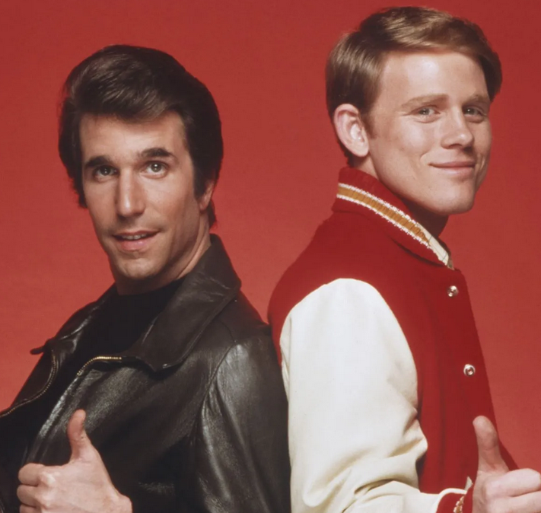
Name a TV show that spun off from Happy Days

Slide 47

COMING UP ARE GENERAL SECRETS TO DATING AND RELATING TO WOMEN AS A MATURE MAN

Slide 48
CONSIDERATIONS BEFORE ENTERING INTO AN ADULT LONG-TERM RELATIONSHIP
What are the boundaries of your relationship? Do you really want or need the same kind of relationship you’ve had in the past with other women? (This is a sobering question, isn’t it?)
What do the two of you need to know about each other’s real-world situation?
  Financial condition
  Familial responsibilities
  Health-related matters
  Career concerns
What if you both own homes?
What if relocation is required?
  Never become emotionally attached without considering this
  Family ties matter more than professional ones
  There is going to be a right answer, and it shouldn’t come down to either convenience or chivalry
These topics (and those that follow on the next two slides) all have to be discussed before getting serious.

Slide 49

SHOULD YOU GET MARRIED (AGAIN)?
There has to be a solid reason WHY.
To pre-nup or not to pre-nup? (complications of life accomplishment and net worth)
Be current with the common law marriage situation in your state, etc.
Know exactly what you have to gain and lose.
Make your own decisions, and they can’t be purely emotional ones.

Slide 50
WHAT IF SHE HAS KIDS?
Her kids who still live at home
  Out of the mouths of babes…
  Their opinions will matter, but should not be definitive
  Expect unreasonable demands and other behavior, and never respond in anger (let alone in kind).
  You and only you can decide if you’re willing to live with them. And they’re not going away.
  They’ll be their mother’s top priority, and that’s nothing against you.
Her grown children
  Adult kids aren’t necessarily less complicated than kids who are still at home. They may be MORE so.
  Fears are related as much to the Casey Kasem situation as to their inheritance.

Slide 51
OTHER PEOPLE IN YOUR LIFE AND THEIR PESKY OPINIONS
What about YOUR kids, regardless of age?
  Everything above still applies, regardless of who is the birth parent
  The amount of time you’ve been single after divorcing/losing Mom will NEVER be long enough.
  Remember also their relationship to their mom will always be sacrosanct, even though you have to live your life.
What about the kids you perhaps have together someday?
  Is your energy level up to the challenge?
  What are the psychological ramifications of them having both parents at home, unlike their half-siblings?
  Is the “empty nest” overrated?
Dealing with aging parents…maybe even living in.
  This is nothing to be ashamed of. You are NOT “living at home”.
  Nevertheless, you may have to plan around the reality of the situation.
Your friends may have opinions, but weigh them carefully and look for patterns
Can you socialize with her? Can you take her to corporate functions?

Slide 52
THE INFAMOUS “REUNION MAGIC” FACTOR
Reconnecting with old-flames from years ago or “Reunion Magic”. It’s a thing…be it at in-person reunions or on social media.
BUT…the caveat is you are NOT who you were back then, and that may be a good thing.
The “J. Geils Effect” of finding women on Facebook you knew years ago…your fantasy has just been sold.
On the other hand, don’t be surprised if the “prom queen” vote would likely go VERY differently were it held today. You may be shocked and amazed.
Understand both you and SHE are not who you were when you were 18 or 22. This could be for better or worse.
People tend to get more politically conservative and more religiously jaded.
You have to accept her earlier mistakes…and it helps if you accept YOURS as well.

Slide 53

ONLINE DATING AND APPS
Do you HAVE to use “Our Time”? Should you?
What age range should you set in your profile?
What kind of pics work best?
Does the Projection Profile methodology change?
Sugar daddy danger: the ridiculous trap that is “arrangement” sites or sugar baby sites.
  How the scam works
  Yes, women do this for full time work
  It’s OnlyFans money without having to get naked.
  Same holds true for hot girls who “Friend” you on FB.
  If you suspect it’s a scam, it likely is.
Related: Watch your social media…avoid blasting your ex. Also be sure to Google yourself. Protect your online reputation.

Slide 54
WIDOWS AND WIDOWERS
Words matter: There are no “ex-spouses” involved here.
Many who lose a spouse are VERY relationship-ready.
Remember, they didn’t purposefully end their previous relationship.
It’s human nature to avoid those who are experiencing an uncomfortable crisis. Rise above that impulse and you may find a true gem of a woman.
If you are a widower…
  Only you can decide not to live in the past.
  Would she want you to be alone?
  Work hard to be ready again. It’s good for you.
If she is a widow…
  Make no assumptions about what her relationship with her husband was like.
  Don’t feel sorry for her and/or throw a pity party.
  If she wants to talk about it, go for it. If not, wait for her to get there.

Slide 55

POINTS DESERVING CONSIDERATION
Defeating the stigma of being a “distinguished bachelor” (i.e. never married, no kids at 40 or older…women are ruthless about this!)
Considerations for first-time fatherhood at 40, 50, over 60.
How dads and moms attract each other with nuance (i.e. dad jokes are funny to moms)
Menopausal women (a “change of life”, literally)

Slide 56

MORE POINTS DESERVING CONSIDERATION
What to do if you meet someone in a loveless/sexless/medically challenged relationship
You’re retired, she isn’t. What to do? If she’s working and has kids it’s going to throw a HUGE wrench in the works, isn’t it?
The impact of sudden loneliness…it’s very real, and devastating. It messes with your mojo almost overnight.

Slide 57
FOR MORE
Visit https://www.scotmckay.net
FREE download of Deserve What You Want
FREE episodes of The Mountain Top Podcast
Talk to me FREE for 25-minutes
Masterclass season tickets

Slide 58
©2022 X & Y Communications. All rights reserved worldwide. Copy and/or distribution is strictly prohibited without express written permission from the publisher.
THANK YOU

Slide 59
QUESTIONS AND ANSWERS

