Slide 1

Stop Attracting The WRONG Women, Choose The RIGHT One Instead
Host: Scot McKay
July 2022

Slide 2
PLAN OF ACTION
There are plenty of practical steps, and we’ll hit the ground running very shortly.
Most of what I’m about to present is BRAND NEW. Any info I bring up from previous programs will be elaborated upon.
There will be contest questions asked a few times during masterclass, w/ prizes to the first correct responder.
Time is reserved at the end for all of your Q&A, although you can submit questions during the class.
Yes, this is being recorded. You will have full access to the video and the slides in a dedicated portal.

Slide 3
GROUND RULES
Come with an open mind and a positive attitude.
Although this slide deck will be made available to you, take notes as you see fit.
Turn off any and all distractions.
Please do not unmute yourself unless it’s your turn to speak.
Abusive, disruptive behavior will not be tolerated. We will practice mutual respect.

Slide 4

WHY AM I THE GUY TO TEACH THIS MASTERCLASS?
Once upon a time, I personally got this ALL WRONG
I did the work to do it RIGHT the next time
I’m here to help you take the shortcut to avoiding my previous mistakes
I’m also here to help you make all the RIGHT moves from now on
I’ve now been “walking the talk” for 16+ years
Your vision of a wonderful life with a great woman may be different than mine, but nevertheless you SHOULD attain it…and I’m here to help.
Importantly, I’m not the coach for beginners or “basket cases”.

Slide 5
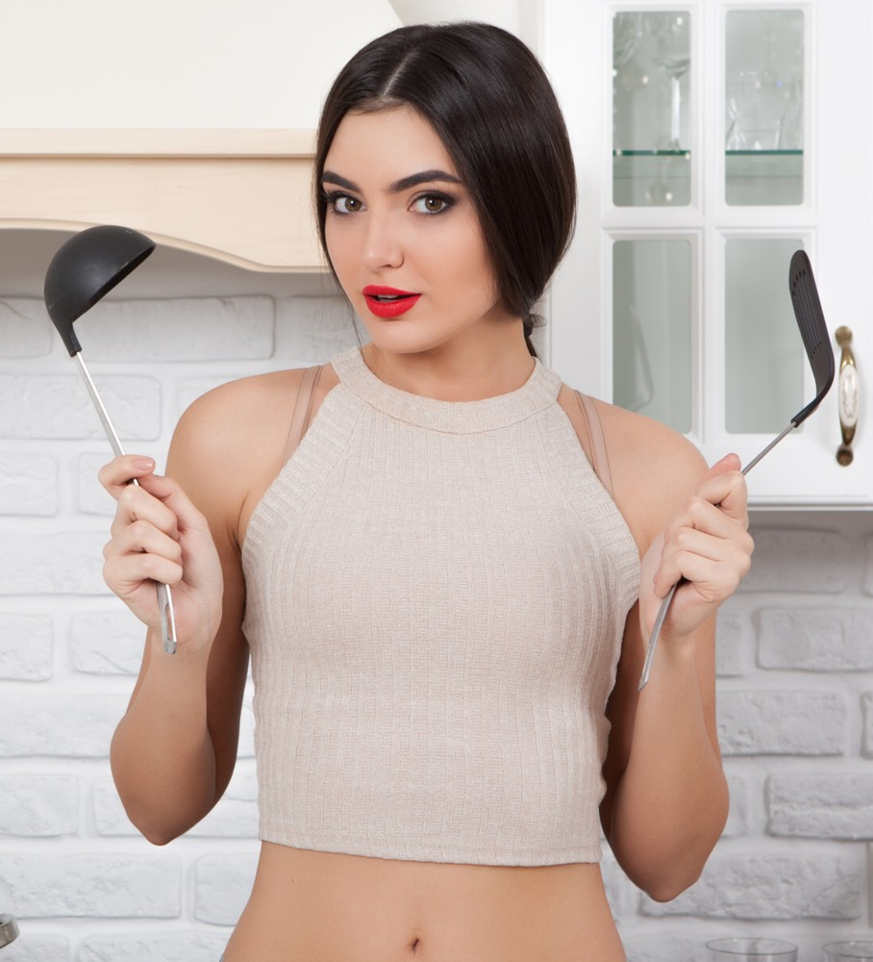
FIRST AND FOREMOST: MEN AND WOMEN ARE DESIGNED FOR BENEVOLENT PARTNERSHIP
Think about it: This is obviously the “Intelligent Design”
Women are NOT “the enemy”.
The truth is WE are typically our own worst enemy.
Consuming negative online content that paints women as adversaries is like “junk food”.
Women offer SO much more than just sexual pleasure.
I have never heard a man use the terms “sealing the deal” or “closing the lay” who is actually successful with women.

Slide 6
START HERE:
“So if this all makes so much sense and works so brilliantly and elegantly, why is there so much confusion? Why isn’t this easy?”

Slide 7
“OBSTINENCE LEADS TO ABSTINENCE”

Slide 8
FIRST, YOU HAVE TO KNOW WHO YOU ARE LOOKING FOR
“If you aim at nothing, you’ll hit it every time.”
Most men have NO IDEA who they want, and cast way too large a net, especially online.
Most men “wing it” in this area of life, even as we tend to be goal-oriented in literally EVERY other area.
You absolutely have to know WHO you want, yet hardly ANY men can articulate it. (This is without bias. You can want a traditional family values housewife or a bisexual circle for all I care. Just have your eyes open and be decisively intentional.)
But Indeed, knowing who you want starts with knowing who YOU are. This is why we as men generally freak out when women ask, “What are you looking for?”

Slide 9

THE SELF-KNOWLEDGE CONTINUUM
IDENTITY --> CORE VALUES --> INTEGRITY --> CONSISTENCY --> CHARACTER
The beauty of this continuum is it skyrockets your confidence because YOU are now in full control of YOU.

Slide 10
MASCULINITY AND FEMININITY ARE THE FOUNDATION…
…Of finding a great woman.
Masculinity and femininity are the very catalysts of sexual attraction themselves.
Masculinity as women define it matters, as does how it attracts femininity as men define it.
This is why your leadership in knowing who you are and who you’re looking for MATTERS.

Slide 11
WHATEVER HAPPENED TO NATURAL SEXUAL POLARITY?
Masculinity has been trivialized--if not vilified--as part of the grand design behind a long-term social strategy
Breakdown of the family unit
Neutering “the man of the house” so that power rests with those in charge
Masculinity with an open definition renders the entire concept utterly nonexistent, and confuses even us as men.
We then start feeling isolated in our desire to be naturally masculine, and get seriously confused.

Slide 12
TRUTH OR “CONSPIRACY THEORY”?
I’ve noticed that “conspiracy theory” is a term that is almost always weaponized against people who are thinking a few chess moves ahead of the desired narrative enough to present a challenge to it.
Meanwhile, the “silent majority” of women are still primally attracted to natural, virtuous masculinity…and importantly, they’re the RIGHT women, not the WRONG ones.

Slide 13
IT’S NO WONDER WELL-MEANING MEN CAN GET OFF TRACK HERE
Witness the proliferation of masculinity gurus who are really machismo gurus (e.g. debate w/ one such guru that women are only interested in dominant leadership, not kindness)
But compassion and kindness can easily be considered masculine traits
The difference between “masculine” and “macho”, and the female equivalents for comparison
So then, not all traits are either masculine or feminine. Those that are merely human—and virtuous—are what I call “connectable” traits. (e.g. honesty, generosity, kindness, punctuality, optimism, confidence, sanity, health, etc.)
It’s THESE traits that combine with masculine and feminine ones respectively to make someone truly “relationship ready”.
Therefore, strong, confident women are good women. These are HUMAN traits, not masculine or feminine traits.

Slide 14
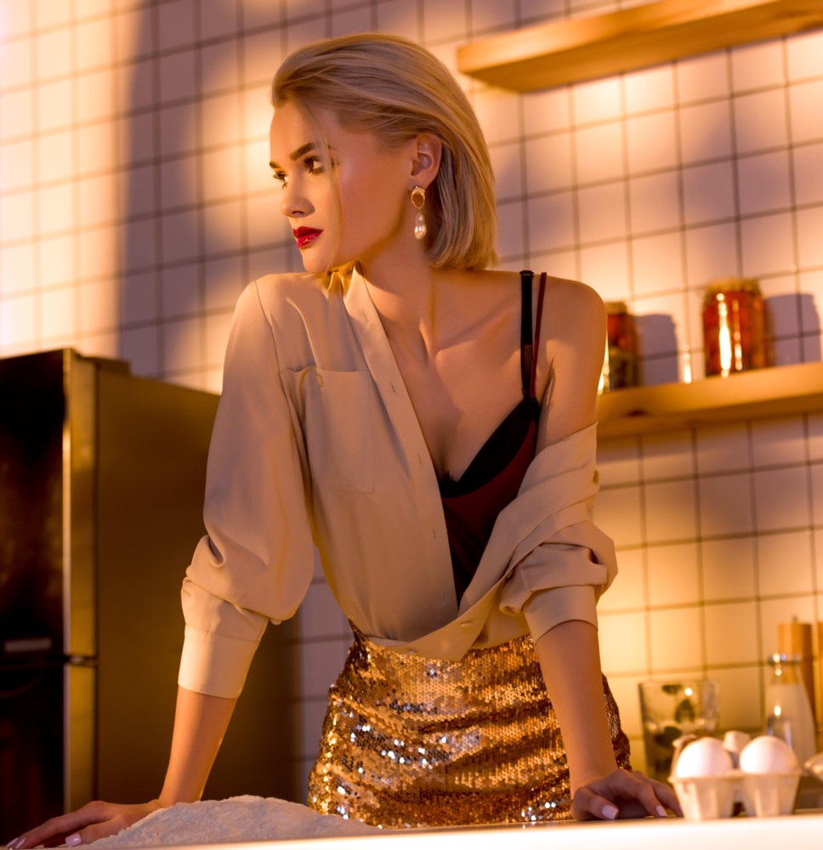
MYSTERY SOLVED: WHY OLDER MEN GET BETTER WOMEN
“Younger” isn’t necessarily “better”, but older men get the younger women also.
It takes maturity and wisdom to attract a woman who both values and represents those same traits.
Evolved masculinity MATTERS.
Younger men come to me specifically because I teach these secrets to them without the need for compiling birthdays.

Slide 15
IDENTITY + FOCUS + MASCULINITY + CONNECTIBILITY = CHOICES
Next, you will find you have CHOICES. No more clouded judgment due to desperation or lack of options.
He OR she with OPTIONS is the chooser, not the chaser.
Ideally, the right man and woman CHOOSE EACH other. NOBODY chases. If you’ve ever fallen for a pitch to “get women to chase you”, then you now know that was based on an under-evolved viewpoint.
Couples who CHOOSE each other have staying power over the long-haul.

Slide 16

SO…ABOUT THAT “CONNECTABILITY” THING. IS THAT ANYTHING LIKE “COMPATIBILITY”?
Yes indeed, they are integrally related…and that’s coming right up.

Slide 17
BUT FIRST, IT’S CONTEST TIME
First to respond correctly gets a FREE copy of The Leading Man

Slide 18
Name a famous man—either real or fictional—who is with the WRONG woman.

Slide 19
WHAT TRAITS MATTER FOR TRUE COMPATIBILITY
All “connectable” traits (see Invincible: e.g. honesty, generosity, kindness, punctuality, optimism, confidence, sanity, health, etc.)
Masculine/Feminine polarity (of course)
Faith, character and values
Views on money
Views on parenting (including parenthood in general)
Views on politics (an unfortunate recent addition)
Views on macro-lifestyle (how to vacation, dietary restrictions, etc.)
Long-term pathway
You marry her, you marry her family (to an extent)

Slide 20
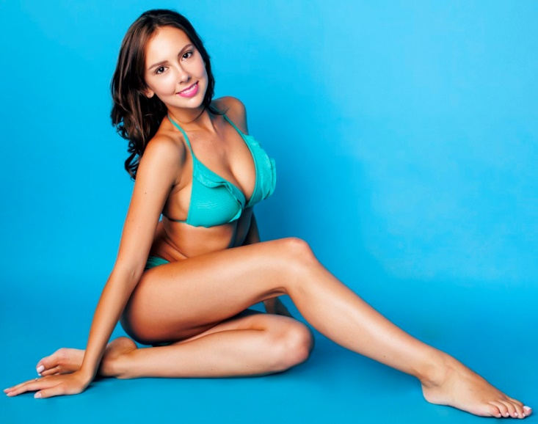
SEXUAL COMPATIBILITY
What can you really influence?
Physical compatibility
Pheromonal synchronicity
Reproductive compatibility
Sex drive
Sexual personality
Spiritual elements/sexual adventure
Ability to reconcile past sexual experience
Guilt, shame, brokenness/sexual scars

Slide 21
OVER-RATED MEASURES OF COMPATIBILITY
Anything that only matters AFTER you’re mutually attracted to each other
  Shared interests up front
  Shared vs. diverse gifts and talents
  Shared background/experiences
  Being “impressive”
Support for “The Current Thing”
Conformation to an arbitrary “checklist” built from random and/or imaginary elements
Introversion/extroversion
Her being equal in intelligence and/or ambition
Right-brained/left-brained
Willingness/proficiency in a certain sex act
Stubbornly selfish motivation
ANY unreasonable or impossible expectation (e.g. Christian Hindu example)

Slide 22
BUT WHEN YOU GET RIGHT DOWN TO IT…
…SOME PEOPLE ARE READY TO BE ONE HALF OF A GREAT RELATIONSHIP, AND SOME JUST ARE NOT.

Slide 23

WHO ARE THESE PEOPLE?

Slide 24
COMMON AVATARS OF WRONG WOMEN
These are the women who have boyfriends for two years…but still no ring on their finger.
Double-Standard Chick
The Immature Flake
The Arrogant Charmer
“Beauty Is Enough” Girl
The Jealous Abuser
The Pretender
Angry At Men (But Hot)
Bat-Shit Crazy Woman

Slide 25
COMMON NEGATIVE THREADS
Hates men
Hates self
Angry/pessimistic
Selfish, high-maintenance
Drama queens
Out-to-lunch, or even flat out insane
Settling physically
Cheapening the relationship (e.g. glib use of the “D” word)

Slide 26

COMMON AVATARS OF
RIGHT WOMEN
These are the women who can’t get past third dates without being proposed to.
“Doesn’t Know She’s Beautiful” Woman
Self-Sufficient, But Appreciates Masc./Fem. Roles
Easy-Going, Yet Gritty Chick
The Easy Audience
Level-Headed Gem
Manic Pixie Dream Girl (This is controversial)
Optimistic, Generous, Survivor

Slide 27
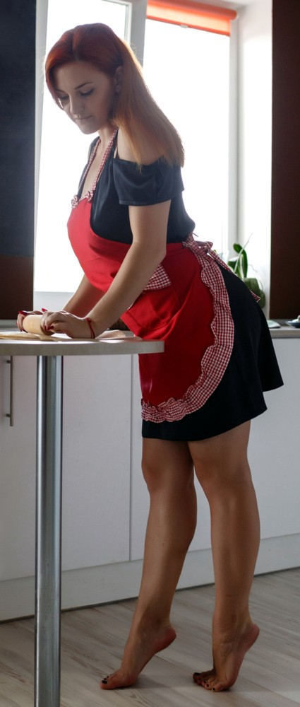
COMMON POSITIVE THREADS
Likes men
Solid self-esteem
Optimistic
Generous
GETS you (you think alike)
Is SEXY to you
On your team…no disrespect, no insults, no pettiness
Equal partnership, without “sameness”

Slide 28

NORMAL ISSUES IN A HEALTHY RELATIONSHIP
Cranky or “hangry” moments
Minor disagreements
Compromise (which sometimes means de-prioritizing self for her bigger priority)
Friend or family drama
Occasional broken promises of a “procedural” nature
Sometimes a selfish decision WILL be made
Innocuous enjoyment of attention from MOTOS

Slide 29
WHAT NOT TO TOLERATE
Let TGR-R be your guide
Major breaches of trust
Any type of domestic violence (she’s not off the hook because she’s female)
False accusations
Being used (financially, or in any other way)
Extreme jealousy
Stoking jealousy (e.g. creating “triangles” with other dudes)
Double-standards/unequal partnership
Selfishness/lopsided contribution
Guilt trips/power struggles
Love of drama
Unreasonable expectations
Unexplained disappearances…either physically OR emotionally

Slide 30
“SO IS WHETHER SHE’ S THE RIGHT OR WRONG WOMAN OUT OF MY CONTROL?”
“I mean, as a man aren’t I supposed to LEAD?”
GREAT QUESTIONS…

Slide 31
BUT FIRST, IT’S CONTEST TIME AGAIN
First to respond with a valid answer gets a FREE copy of Get Together, Stay Together.

Slide 32
Name a famous man—either real or fictional—who is with the RIGHT woman.

Slide 33
WHAT YOU CANNOT INFLUENCE
Genuine mental illness
Genuine brokenness (e.g. history of abuse)
Addictions of any kind
Extreme selfishness/narcissism
Low self-esteem
Faith differences (this is controversial)
Raw intelligence
Legitimate character issues
Anything she’s happy with and stubbornly clinging to
Who she actually is at her core (this should be obvious, but e.g. her race, her culture, etc.)

Slide 34
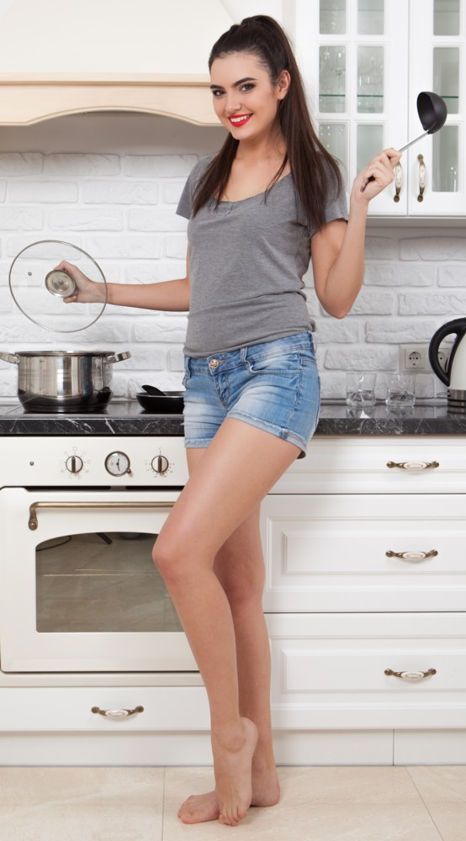
WHAT YOU CAN INFLUENCE WITH MASCULINE LEADERSHIP
Shared interests (these do NOT have to be there up front)
Non-pathological personality flaws (e.g. negativity, gossip, laziness, lack of enthusiasm, lack of sense of humor, being uptight)
Sexual skill and inhibition
Encouragement to take action
Getting out of a “rut” (e.g. being “set in her ways”)
ANYTHING purely fear-based (e.g. adventure, action…NOT full-on phobias)

Slide 35

CHECK IN TIME…
HOW ARE WE DOING?

Slide 36
SETTLING: THE STRUGGLE IS REAL

Slide 37
THE PSYCHOLOGICAL ALCHEMY OF SETTLING
Self-esteem is HARD
Feeling we don’t deserve what other men do, therefore settling is deemed inevitable (or even normal)
Lacking options weighs on our psyche
We’ve been easily manipulated by women we’re not so into
We’ve been hurt by women
Pining over “The One Who Got Away” (i.e. “alpha widowers”)
“Doesn’t everyone really settle?”

Slide 38
SUBTLE SYMPTOMS OF SETTLING
She’s hot, but you don’t like her
You like her, but she’s not hot
Justifying bad behavior…on EITHER of your part
Giving without reciprocation…on EITHER of your part
Reticence to commit on EITHER of your part
New/different relationship, same wrong chick (your expectations translate to leadership)

Slide 39
LIFE SUCKS WHEN YOU SETTLE
Nose against the window gazing at “greener pastures”
Anger at lesser men with better women
Resentment toward the woman in your life…and she’ll resent you too
Greater likelihood of drowning in porn
NOTHING good comes from settling, in the short- or longer-term. It feels like a life sentence.
The Clincher: Murphy’s Law says you’ll meet the RIGHT woman, shortly after settling into a committed relationship with the WRONG one.
Such relationships are DOOMED from the start…and yes, MOST people do settle. (See: “divorce rates”)

Slide 40
THE CRUEL DOUBLE-EDGED SWORD OF SETTLING
The only thing worse than settling is being settled FOR.
Had you not settled, BOTH of you would likely have found your better match.

Slide 41
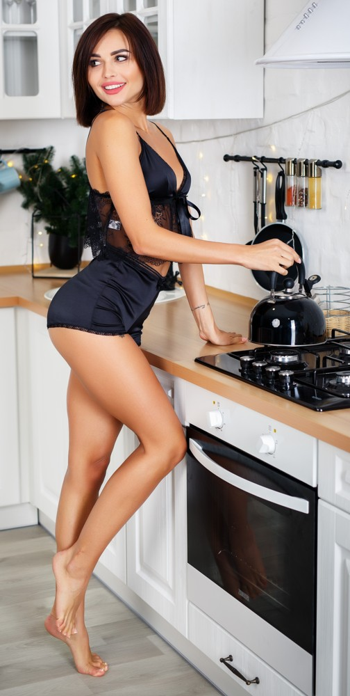
THE RIGHT WOMAN: WHY NOT YOU INSTEAD OF SOME OTHER GUY?

Slide 42

NEXT WE’LL GET DOWN TO SOME DEEPER MINDSETS AND PRACTICAL STEPS…

Slide 43
…BUT FIRST, OUR THIRD AND FINAL CONTEST
Correct answer gets FREE access to the previous Masterclass of your choice

Slide 44
Name a popular song about ending up with the WRONG woman

Slide 45
CHALLENGE: CAN YOU CONQUER YOUR FEAR OF FINDING THE RIGHT WOMAN?
This is classic “fear of success”
Stop fearing the double-standard imposed by Feminism toward “toxic masculinity”. Toxicity is not gender-specific.
Understand the legal system is catching up to bad women
Divorce court is for BAD marriages, not GOOD ones
You are NOT creepy, weird or pushy unless you are creepy, weird or pushy

Slide 46
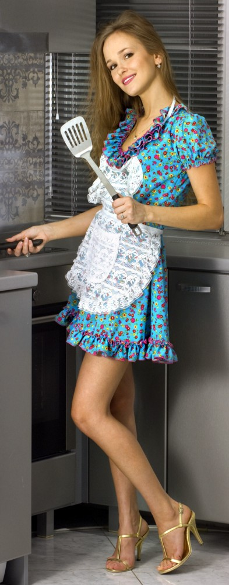
THE GREAT MYTH
Most men find themselves assuming women process attraction like men do. They do NOT.
The one sticking point we focus on is likely NOT the most globally common reason why women “reject” a certain man.
Women may have a mental checklist, but they fall in love by surprise.

Slide 47
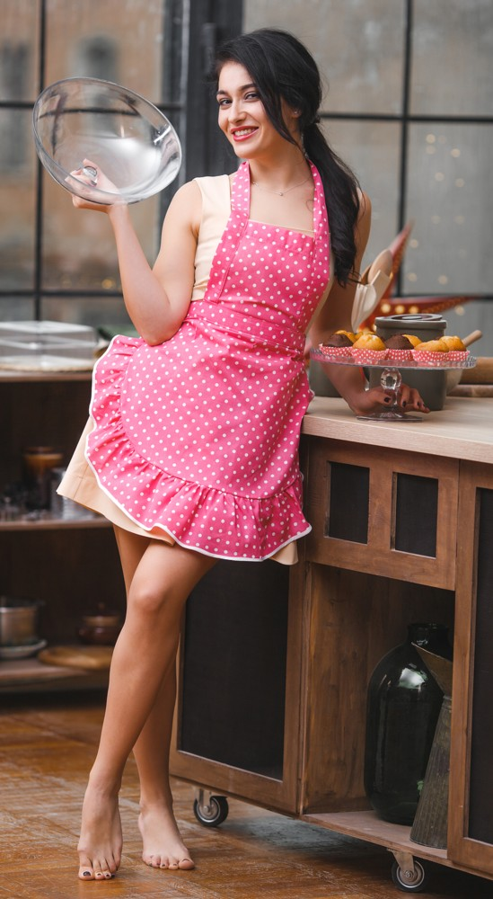
THE INFAMOUS DATING COACH DEBATE
On a panel during a live speaking event, other coaches were repeating the trope that women are attracted to “height, looks and money”.
I told them I would give them ALL THREE of those advantages, if I could choose three others:
  Confidence
  Full understanding of how masculinity and femininity work
  The ability to make women laugh
Figure this out, you’re all but GUARANTEED to win the heart of a truly compatible woman.
All of the other “advantages” are mere bonuses.

Slide 48
“BUT AREN’T ALL WOMEN THE SAME?”
It is NOT true that all beautiful women are stuck up, shallow, selfish, gold diggers, etc.
But the “connectable” women are NOT going to shack up with a man who doesn’t respect women in general.
Placing the proverbial shoe on the other foot, consider how a sexually attractive woman who believes “men are no good and only want one thing” will likely live a self-fulfilling prophecy.

Slide 49

CONQUER INADEQUACY
The #1 trait of men who are successful with women is they BELIEVE women should want them (i.e. confidence).
If you are “big four” and deserve what you want, you are ENOUGH.
You are indeed compatible with the kind of woman who is right for you. She’ll want you MORE, not LESS for that reason. (zero-out the “Too Good To Be True Factor”)

Slide 50
NEVER FALL FOR SOCIETAL TRAPS AND MYTHS
MGTOW and “redpilled” content is junk food that steals your health and prosperity.
Most BAD and ill-advised marriages end in divorce, not most GOOD ones built on the right foundation.
Wanting the “whole package” is NOT shallow.
Jerks may get women, but not with long-term positive results.
Don’t listen to mere opinions of others regarding very debatable definitions of “quality” women (e.g. on single moms, women of certain races, older or younger women, bisexual women, etc.)
You can expect to have a woman who is more physically attractive than you are (TRUTH: women do NOT want a man who is “prettier” than she is).

Slide 51
SELF-INFLICTED “GOTCHAS”
The right woman for you depends on YOUR definition, not a media-driven societal one. Your “type” of woman is your 10. What the media says and/or who you think is going to impress your buddies doesn’t matter. (See: “The Depth Chart”)
Failure to change bad habits, and/or inaction
Fear of stepping up and “adulting” (e.g. men who still live at home)
Taking responsibility/ownership over victimhood leads to disrupting bad patterns of attracting/tolerating the wrong women
  We keep attracting crazy/selfish/evil ones because we expect that flaw and therefore tolerate it.)
  The pattern of being used because we’re optimistic/generous
  Mr. Nice Guy
  Failing to be masculine (i.e. JBF Zone)
Failing to come to grips with the “only if” woman

Slide 52
WHAT TO DO IF YOU’RE WITH THE WRONG WOMAN RIGHT NOW
Pay attention to your gut feeling, and don’t discount clear patterns of admonition from those who care about you.
Get VERY practical rather than emotional in terms of your decision making. Rationalizing/ignoring major issues is symptomatic of settling.
Guard against poverty mentality (i.e. you CAN and WILL do better)
Gear up for the guilt trips
Be al dente (tender, but firm) during the breakup (see breakups book in the DL Area)
Above all…NEVER get brainwashed into thinking you owe the wrong woman anything, apart from marriage and/or co-parented children (e.g. water under the bridge, affection from third-parties, shared possessions)
The least painful time to break up in history is RIGHT NOW.

Slide 53
HOW TO MOVE ON FROM THE WRONG WOMAN
Throw out the “nice guy” rules
Total cut-off of communications
Unfriend on social media, and block if you must
Beware “end around” games by family and friends, or any other form of manipulation
Evaluate the patterns of toxicity/negativity
Be a ruthless scout for “red flags” going forward
Don’t fall victim to double-standard mentality. Use TGR-R without regard for gender.
No “pity party” longer than 24 hours
Stand your ground, understanding ex-back psychological tricks

Slide 54
WHAT IF SHE’S PREGNANT?
This is an extremely complicated issue, without boilerplate answers, so I’m covering this with some reservation.
Rule #1: She pees on a stick or there’s no pregnancy
Beware motherhood-minded women up front, and don’t be naïve about it.
You will find out what your real socio-political beliefs are REALLY quickly if/when an unplanned pregnancy happens.
The mother decides whether or not to have the baby, and you should be responsible for your actions.
Generally speaking, it’s NOT a good idea to continue a bad/toxic relationship for the sake of a child.

Slide 55
PRACTICAL WAYS TO GREATLY INCREASE YOUR CHANCES OF MEETING THE RIGHT WOMAN
Build the habit of talking to ALL women.
Be ready to meet her ANYWHERE. Don’t depend on specific venues where you perceive she might be.
Wonderfully, the more CONSISTENT your character is, the greater the likelihood you will meet a woman of CONSISTENT CHARACTER who matches up with you. Inconsistency (i.e. no character) or bad character is the “kiss of death” if hoping for a solid long-term relationship.
Trade PUA tricks and “running game” for “big four” authenticity

Slide 56

WHAT TO DO THE VERY MOMENT YOU MEET A POTENTIALLY GOOD WOMAN
Give her space
Establish safety, security and “normalcy”
Practice “warm levity”
Let your natural masculinity do the heavy lifting
Appreciate her at a holistic level
Don’t rush anything. Relax and believe, and she’ll follow.
Don’t project the future onto her. Test and approve your compatibility over time.

Slide 57
IMPORTANTLY…
…You may find that all conventional dating advice goes out the window when you’ve met the right woman.
That’s actually okay, and to be expected.

Slide 58
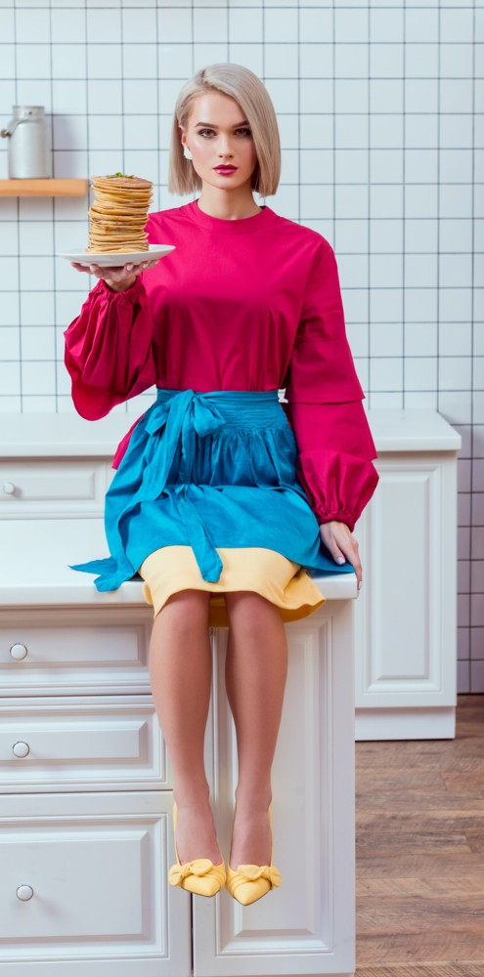
FINAL NOTES: PROCESS AND TIMING
Online and offline strategy can both be effective.
Short-term fling mindset if not relationship-minded just yet: Yes, refuse the wrong women.
Dating multiple women on the way to an LTR is a great idea…and fine tunes your sense of the right woman.
Date long enough and allow yourselves room to evaluate (it can’t ever be a purely emotional decision)

Slide 59
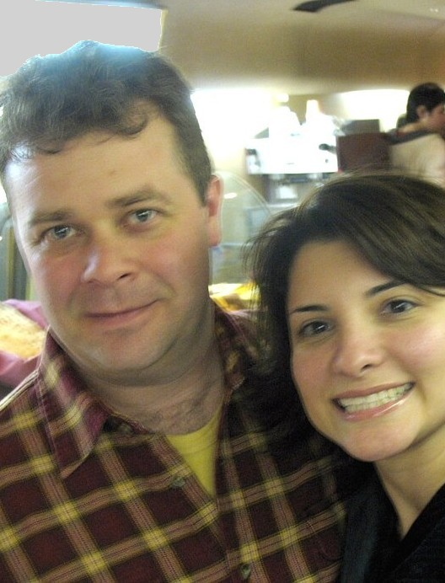
16 YEARS AND GOING STRONG
Attraction, good character, masculine/feminine polarity, optimistic generosity, common values and straight-up GETTING each other give you the BEST chance at long-term success with a great woman.
There has never been even ONE day over the course of all that time that has ever even been close to what almost ALL days were like with my ex-wife.

Slide 60
FOR MORE
Visit https://www.scotmckay.net
FREE download of Deserve What You Want
FREE episodes of The Mountain Top Podcast
Talk to me FREE for 25-minutes
Masterclass season tickets

Slide 61
QUESTIONS AND ANSWERS

Slide 62
©2022 X & Y Communications. All rights reserved worldwide. Copy and/or distribution is strictly prohibited without express written permission from the publisher.
THANK YOU

